Slide 1
Story Architecture
Sally Bosco

Slide 2
Story structure vs. Story Architecture
In order to have solid story structure, your must first create the underlying framework. Otherwise it’s like trying to put clothes on a jellyfish.
Structure is the foundation, girders, support beams that allows a building to stand upright.
But structure is bland without art.
Architecture describes the artful aesthetic of a building.

Slide 3
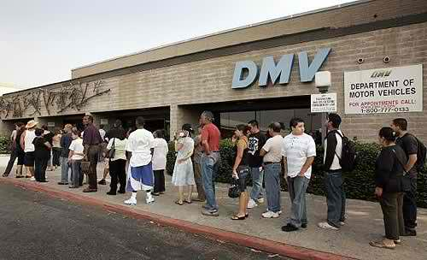
Story structure vs. Story Architecture
Structure = your local DMV

Slide 4



Story structure vs.
Story Architecture
Architecture = Art = Falling Water by Frank Lloyd Wright, Taj Mahal or Zaha Hadid.
Notes:
Story structure is the sequence of your scenes that result in a story well told. Story architecture is the empowerment of those scenes through compelling characterization, powerful theme, fresh concept, and a voice that brings it all to life with personality and energy.

Slide 5
Basic Four Part Model
Part 1 The Setup/Orphan | Part 2 The Response/Wanderer
Part 3 The Attack/Warrior | Part 4 The Resolution/Martyr
Notes:
It helps me to think about the plot in big blocks like this. With some of the other formulas, like Save the Cat, I can get lost in the details.
Everything in the second box is there to make the first box meaningful by placing what the reader is now rooting for in jeopardy.
The first box may not make sense until the second box is opened, and when it is, readers are already invested in your hero.
The hero has a different experience and acts differently in each box.

Slide 6
Definitions
Plot Point: A plot point, often called a reversal, is a significant event within a plot that spins the action around in another direction.
First Plot Point: The moment the hero takes on the problem. I
Pinch Point: is meant to show your readers the powerful forces pushing against your hero.
Midpoint: This is where your character moves from being reactionary to “proactionary.”
Second Plot Point: This is where the character knows what needs to be done and then sets out to finish it.
Resolution: This is where all the strands of your story’s plot should come together.
Notes:
Plot Point: A plot point, often called a reversal, is a significant event within a plot that spins the action around in another direction. The scenes that are game changers are called plot points. Plot points keep your story moving forward.
First Plot Point: The moment the hero takes on the problem. It forces your lead character out of his normal world. Your main character can’t go back to normal life after this point. It’s the moment when the setup ends and everything changes for your character.
Pinch Point: is meant to show your readers the powerful forces pushing against your hero
Midpoint: This is where your character moves from being reactionary to “proactionary.” This doesn’t mean that he isn’t still being pursued it only means that now he has a purpose to his mission.
Second Plot Point: This is where the story takes its last turn toward the resolution. This is where the character knows what needs to be done and then sets out to finish it.
Resolution: This is where you story ends. This is where all the strands of your story’s plot should come together.

Slide 7
Part 1 – The Setup/Orphan
The opening hook must pose a question. You must pique your readers’ curiosity.
The mission of Part 1 is to set up the plot by creating stakes, backstory, and character empathy while foreshadowing the forthcoming conflict.
In Part 1 the hero is an orphan unsure of what will happen next. We feel for him, we empathize with him..
Part 1 ends when the hero is made aware of the arrival of something new in his life that is very challenging or scary. This is the First Plot Point. Everything changes for your character.
The character’s reaction to the First Plot Point marks the beginning of Part 2.
Notes:
The opening hook must pose a question. You must pique your readers’ curiosity. Makes the reader want to know what’s going to happen.
The Part 1 box sets up everything that follows. It foreshadows the story’s main antagonistic force.
Part 1 is mission driven. The mission of Part 1 is to set up the plot by creating stakes, backstory, and character empathy while foreshadowing the forthcoming conflict.
In Part 1 the hero is an orphan unsure of what will happen to him next. We feel for him, we empathize with him. The more we empathize with what the hero has at stake, the more we care about him when all of that changes.
Part 1 ends when the hero is made aware of the arrival of something new in his life: a new quest, a sudden need, a calling, a journey, which is very challenging or scary. This is the First Plot Point. Everything changes for your character.
The character’s reaction to the First Plot Point marks the beginning of Part 2.

Slide 8
1. The Most Important Moment: The First Plot Point
Something enters the story in a manner that alters the hero’s status, plans and beliefs.
What the hero does in response becomes the story’s conflict.
This is the moment when everything changes.
What the hero thought was true may not be as advertised. The stakes are now on the table.
Everything that happens before the first plot point is a setup for it.
This is the most important moment in your story.
It happens 20 to 25% into the story.
Notes:
This is the moment when something enters the story in a manner that affects and alters the hero’s status, plans and beliefs, forcing him to take action in response. This puts the opposition in place.
What the hero does in response becomes the story’s conflict.
It is the moment when everything changes.
The arrival of the first plot point means that what the hero thought was true may not be as advertised. It means that safety and status quo are being threatened.
The stakes are now on the table.
Everything that happens before the first plot point is a setup for it.
This is the most important moment in your story, and if you haven’t wrapped your head around this, chances are you’ll never sell a story.
It happenes 20 to 25% into the story.

Slide 9
Part 2 – The Response/Wanderer
In the beginning of Part 2, your character is forced into irreversible action.
Your character is trying to regain his balance, trying to figure out what happens next. The antagonistic force responds, and he is forced to react.
Whatever the hero needs, there must be something opposing the hero’s quest to achieve it. No opposition, no story.
The context to every scene in Part 2 is response.
In Part 2, the hero is a wanderer. His purpose or quest is just beginning.
Everything in part 2 focuses on the hero’s reaction to the new journey, which includes his reluctance to accept it.
Notes:
The first part of Part 2 is where your character reacts to what happened in the First Plot Point. It forces the character into irreversible action.
Your character’s actions are a response. He’s trying to regain his balance, trying to figure out what happens next. The antagonistic force responds, and he is forced to react.
Whatever the hero needs, there must be something opposing the hero’s quest to achieve it. No opposition, no story.
The context to every scene in Part 2 is response. To what? To the new quest, goal, stakes, and obstacles as introduced in the first plot point.
In Part 2, the hero is a wanderer, staggering through a forest of opposition and risks, not cure where to go or what to do. He now has a purpose, a quest, and it’s just beginning.
Everything in part 2 focuses on the hero’s reaction to the new journey, which includes his reluctance to accept it.

Slide 10
2. The First Pinch Point
Definition of a Pinch Point: An example of the power of the antagonistic force that is not filtered by the hero’s experience. The reader sees it herself in direct form.
The First Pinch Point comes halfway through Part 2.
The reader needs a reminder of the unseen monster we know is under the bed.
Sooner or later the reader—not the hero—needs to meet the antagonist again, to look in its eyes and understand what it wants and the power of that desire.
Notes:
The First Pinch Point comes halfway through Part 2. It reminds the readers of the antagonist’s power.
A Pinch Point is main antagonistic force. The reader needs a reminder of the danger, the stakes and the implications, the unseen monster we know is under the bed.
Sooner or later the reader—not the hero—needs to meet the antagonist again, to look in its eyes and understand what it wants and the power of that desire.
Definition of a Pinch Point: An example, or a reminder, of the nature and implications of the antagonistic force, that is not filtered by the hero’s experience. The reader sees it herself in direct form.

Slide 11
2. The Midpoint Scene
The Midpoint Scene is at the end of Part 2: new information changes the experience and understanding of either the reader or the hero or both.
Everything changes all over again. In many ways, the Midpoint is the second Inciting Incident. The largest difference is that the character’s response is no longer just a reaction. This is where he begins to take charge of the story and act out against the antagonistic force.
This can be previously hidden information or completely new information.
At the end of Part 2, just when the hero thinks he has figured it out, when he has a plan, everything changes.
Notes:
The Midpoint Scene is at the end of Part 2: new information that enters the story squarely in the middle of it that changes the contextual experience and understanding of either the reader or the hero or both.
Everything changes all over again. In many ways, the Midpoint is the second Inciting Incident. The largest difference is that the character’s response is no longer just a reaction. This is where he begins to take charge of the story and act out against the antagonistic force.
This can be previously hidden information or completely new information.
At the end of Part 2, just when the hero thinks he has figured it out, when he has a plan, everything changes, and the reading experience changes.

Slide 12
Part 3 – The Attack/Warrior
In Part 3, the hero tries to fix things. Your character stops reacting and starts acting. As of the midpoint, your character has become someone new.
The hero starts to conquer inner demons.
Be on guard against your character’s reacting to similar situations in the same way over and over again. If he does, you’ve allowed him to slide into stagnation.
Something—new information, new awareness—needs to enter the story to serve as a catalyst for the hero’s evolution from the wanderer/responder in Part 2 toward attacking warrior ways.
Every story doesn’t have a villain, but it must have opposition to what the hero wants.
Notes:
In Part 3, the hero tries to fix things. This is where your plot really begins popping. Your character stops reacting and starts acting. As of the midpoint, your character has become someone new. He’s realizing his full power and stretching his wings to discover what he can do with that power. His crippling inner problems are still getting in the way, but, at the very least, he’s realizing he has to do something either about or in spite of them.
He begins to attack the obstacles before him. The hero starts to conquer inner demons and begins doing things a little differently than before.
Be on guard against your character’s reacting to similar situations in the same way over and over again. If he does, you’ve allowed him to slide into stagnation.
Of course, this can’t happen in a vacuum. Something—new information, new awareness—needs to enter the story to serve as a catalyst for the hero’s evolution from the wanderer/responder in Part 2 toward more proactive, attacking warrior ways.
Every story doesn’t have a villain, but it must have opposition to what the hero wants.

Slide 13
3 – The Second Pinch Point
The Second Pinch Point occurs in the middle of Part 3.
The second Pinch Point can be experienced through the hero. This serves most of the same purposes as the First Pinch Point, including ramping up the stakes and foreshadowing the final battle between the protagonist and the antagonist.
It’s more frightening and unwavering than ever.
And like the hero, the antagonist has evolved, too. He’s learned how the hero is fighting back. The tension and pacing increase.

Slide 14
3 – The Second Plot Point
The second plot point separates Part 3 from Part 4.
The hero learns something that will bring take him one step closer toward doing whatever needs to be done in Part 4 to bring the story to a satisfactory closure.
New information is unleashed. It’s the missing piece of the puzzle.
There is an all-hope-is-lost lull right before the second Plot Point occurs.

Slide 15
Part 4 – The Resolution/Martyr
Pace will pick up here. All characters must be assembled. Subplots must be satisfactorily tied off. Foreshadowing must be fulfilled.
Both hero and antagonist (if there is one) must have time to put into play the final aspects of their plans. The hero must face his inner demons and complete his character arc in concert with the final conflict with the antagonistic force.
The thing about Part 4 is that no new information can enter the story. From the second plot point on, everything the hero has to know needs to have already been put into play.

Slide 16
4. The Third Plot Point
The Third Plot Point must be another life changing event that will lead right into your character’s dark moment.
The thing he wants most in the world will be almost within his grasp only to be dashed away.
What event shatters the protagonist’s seeming moment of victory?
After the Third Plot Point the story is all about character and change. We take a person and force him into a journey that will change him forever.
Ask: How is my character different than he was in the first part of the story?
Because the Third Plot Point is a symbolic representation of your protagonist’s death and rebirth, this plot point often features either literal or figurative death.
Notes:
The Third Plot Point must be another life changing event that will set your protagonist’s feet on the path toward the final conflict. It leads right into your character’s low point/dark moment. The thing he wants most in the world will be almost within his grasp only to be dashed away., smashing him down even lower than before. The Climax will be the period in which he rises from the ashes, ready to do battle from a place of inner wholeness. The Third Plot point is the place from which he must rise.
What event shatters the protagonist’s seeming moment of victory?
After the Third Plot Point the story is all about character and change. We take a person and force him into a journey that will change him for the better, hopefully forever.
Ask: How is my character different than he was in the first part of the story?
Because the Third Plot Point is a symbolic representation of your protagonist’s death and rebirth, this plot point often features either literal or figurative death.

Slide 17
4. The Climax
The Climax (the last 10% of the story) is a moment of revelation for the main character. The character will come to a life-changing epiphany directly before, during or after the Climax.
The Climax will be the period in which he rises from the ashes, ready to do battle from a place of inner wholeness.
Part 4 shows how the hero summons the courage and growth to come forward with a solution to the problem.
The hero needs to be the primary catalyst in the resolution of the story.
That’s why the orphan, then the wanderer, and then the warrior now becomes either figuratively or literally the martyr.
Notes:
The Climax (the last 10% of the story) is a moment of revelation for the main character. The character will come to a life-changing epiphany directly before, during or after the Climax. He will then act definitively upon that revelation, capping the change in his character arc and ending the primary conflict, either physically, spiritually or both.
The Climax will be the period in which he rises from the ashes, ready to do battle from a place of inner wholeness.
Part 4 shows how the hero summons the courage and growth to come forward with a solution to the problem.
The hero needs to be the primary catalyst in the resolution of the story. The hero needs to be heroic.
That’s why the orphan, then the wanderer, and then the warrior now becomes either figuratively or literally the martyr.

Slide 18
4. The Resolution
The Resolution is at the 98% mark of the story. After all the emotional stress of the Climax, readers want a moment to relax.
They want to see the character rising, dusting off his pants, and moving on with life.
And, if you’ve done your job right, they’ll want to spend a little more time with these characters they’ve grown to love. The shorter the better. Your story is essentially over.
Closing lines: their memorability isn’t nearly as important as the feeling with which they leave readers. There should be a sense that your characters’ lives will continue after the story.
Notes:
The Resolution is at the 98% mark of the story. After all the emotional stress of the Climax, readers want a moment to relax. They want to see the character rising, dusting off his pants, and moving on with life. They want to catch a glimpse of how the ordeals of the previous three acts have changed your character, and they want a preview of the new life he will life in the after math of the conflict. And, if you’ve done your job right, they’ll want to spend a little more time with these characters they’ve grown to love. The shorter the better. Your story is essentially over.
Closing lines: their memorability isn’t nearly as important at the feeling with which they leave readers. There should be a sense that your characters’ lives will continue after the story.

Slide 19
4. The Final Act
No new expositional information can enter the story. If anything appears it needs to have been foreshadowed, referenced or already in play. The same applies to characters.
The hero should demonstrate that he has conquered the inner demons that have stood in his way in the past.
The more the reader feels the character’s heroism, the more effective the ending will be.
Notes:
The Final Act:
No new expositional information can enter the story. If anything appears it needs to have been foreshadowed, referenced or already in play. The same applies to characters.
The hero should demonstrate that he has conquered the inner demons that have stood in his way in the past.
The more the reader feels the character’s heroism, the more effective the ending will be

Slide 20
Three Tent Poles
The First Plot Point, at approximately 20 to 25 percent through the story.
A context-shifting Midpoint, at precisely the middle of the story.
The Second Plot point at about 75 percent through the story.
Everything else in your story is connective tissue. Once you know your milestones, those scenes practically write themselves.

Slide 21
Story Milestones –
Three Tent Poles in Red
The opening scene or sequence of your story.
A hooking moment in the first 20 pages.
A setup inciting incident
The First Plot Point, at approximately 20 to 25 percent through the story.
The First Pinch Point in the middle of Part 2.
A context-shifting Midpoint, at precisely the middle of the story.
A Second Pinch Point in the middle of Part 3.
The Second Plot point at about 75 percent through the story.
The final resolution.

Slide 22
Story Analysis – Gone Girl
First plot point: Amy (the wife) confesses from within her diary that she believes Nick, (her husband) may be capable of – indeed, intending to – kill her. This concludes a setup in which the police, and the readers, have been led to believe he is somehow involved with her disappearance.
Amy’s diary will soon surface as part of the evidence exposing Nick’s complicity. In writing this, in telling us about it at precisely this point, she is defining and launching the hero’s story quest, because Nick is about to get nailed for his wife’s disappearance and, presumably, her death.

Slide 23
Story Analysis – Gone Girl
Midpoint: Amy has planned to frame Nick for what will not only be her disappearance, but her murder. Because she intends to kill herself as the grand crown jewel of her frame-up scheme, which she also explains to the viewer, piece by diabolical piece.
In effect, the story transforms from a mystery (discovering what really happened) to a thriller (sticking around to see what will happen).
The fun of the second half of the story is seeing how Nick will discover the truth, and what happens to everyone when he does.

Slide 24
Story Analysis – Gone Girl
The Second Plot Point: Nick is being interviewed on television about the disappearance of his wife. It’s a strategy cooked up by his lawyer, who knows that in the face of all the planted evidence Nick would benefit from some sympathetic public exposure.
At the end of this interview he looks directly into the camera, and promising to take care of her, he tells Amy that he loves her.
Resolution: She wins. A few pages later she slits the throat of her lover (an obsessed old boyfriend) to cement a story that has him kidnapping and holding here, until she took advantage of a weak moment and killed him in her escape.

Slide 25
Exercise:
Take a few minutes to break down the plot of a story you’re working on to its simplest elements using the four part model.
Part 1 The Setup/Orphan | Part 2 The Response/Wanderer
Part 3 The Attack/Warrior | Part 4 The Resolution/Martyr

Slide 26
Six Core Competencies:
Concept
An idea is a seed.
Without planting, nourishment and watering, they are nothing more than little buds.
Sometimes we aren’t sure what seed we hold in our hands. So we plant it, nourish it, and soon it begins to show itself for what it is. What it should become.
If you stare at the seed long enough, you begin to ask it questions. Who are you? What can you do?
You play with the seed until the questions – the what if? questions – begin to possess you. When one of them quickens your pulse, you know your seed has just become a concept.
Notes:
An idea is a seed. An idea is rarely a vetted, viable concept.
Seeds come in all sizes and shapes and purposes. But without planting, without nourishment and watering, they are nothing more than little buds with no story to tell.
Sometimes we aren’t sure what seed we hold in our hands. So we plant it, nourish it, and soon it begins to show itself for what it is. What it should become. In which case, you may need to transplant it from a pot to a yard, because the thing was an oak instead of a tulip all along.
If you stare at the seed long enough, you begin to ask it questions. Who are you? What can you do? And then, when you ask the right questions, those inspired by the literary license to transform any seed in the world to any plant/story species in the world, the questions change.
You play with the seed until the questions – the what if? questions – begin to possess you. When one of them quickens your pulse, you know your seed has just become a concept.

Slide 27
Six Core Competencies:
Character
Love her or hate her, she’s complicated, multi-dimensional.
She has a backstory. She has character arc. And she’s full of inner demons, all of which she denies.
We can relate to her, or at least empathize with her, and she is full of sub-text.
The ending is where true, third-dimension character emerges.
The character is never the story. The character is our window into the story. It’s the character that draws us in, and it’s what happens to the character that provides the stage for us to see who he is.
Notes:
Love her or hate her, there’s no arguing she’s complicated, multi-dimensional.
She has a backstory. She has character arc. And she’s full of inner demons, all of which she denies.
We can relate to her, or at least empathize with her, and she is full of sub-text.
The ending isn’t written yet, and the ending is where true, third-dimension character emerges.
The character is never the story. The character is our window into the story. It’s the character that draws us in, and it’s what happens to the character that provides the stage for us to see who he is.

Slide 28
Six Core Competencies:
Theme
Theme is what your story means. How it relates to reality and life in general.
It can be a principle or an inevitable stage of growing up. It can be subtle or it can be on the nose. It can be contextual, or it can be the centerpiece of the story.
Theme is the relevance of your story to life—to reality, as reflected in your fiction. Theme is love and hate, the folly of youth, the treachery of commerce, the minefield of marriage, betrayal, friendship, loyalty, wealth and poverty, wisdom and greed, lust and laughter.
The story has to pierce the heart of the reader. A great story is always entertaining… and always relevant to life on a personal level.
The theme may not emerge until after you’ve written your first draft.
Notes:
Theme is what your story means. How it relates to reality and life in general. What is says about life and the infinite roster of issues, facets, challenges and experiences it presents. Theme can be a broad topical arena, or it can be a specific stance on anything human beings experience in life.
It can be a principle or an inevitable stage of growing up. It can be subtle or it can be on the nose. It can be contextual, or it can be the centerpiece of the story. And because it can be all of these things, or seemingly none of them yet strangely moving, it is often confusing to writers who can’t quite grasp what it means to the craft of storytelling.
Theme is the relevance of your story to life—to reality, as reflected in your fiction. Theme is love and hate, the folly of youth, the treachery of commerce, the minefield of marriage, the veracity of religion, heaven and hell, past and future, science versus nature, betrayal, friendship, loyalty, Machiavellian agenda, wealth and poverty, mercy and courage and wisdom and greed and lust and laughter.
The story has to pierce the heart of the reader. A great story is always entertaining… and always relevant to life on a personal level.
The theme may not emerge until after you’ve written your first draft.

Slide 29
Six Core Competencies:
Structure/Plot
4 Part Model:
Part 1 The Setup/Orphan | Part 2 The Response/Wanderer
Part 3 The Attack/Warrior | Part 4 The Resolution/Martyr

Slide 30
Six Core Competencies:
Structure/Plot
Let’s talk about sex. Stage setting. Foreplay. Anticipation.
Sex has structure to it, when it comes to what happens when.
And if you doubt that, when was the last time you began with an orgasm and ended it by undressing your partner and pouring a glass of wine?
You know how it ends before you begin. Getting there is the real story.
You discover structure in storytelling by looking beneath and beyond the concept and characters, and discover the sequence of the story’s architecture.

Slide 31
Six Core Competencies:
Scene Execution
This scene has a succinctly defined mission. You know precisely what needs to be put into play, the manner in which it changes the story going forward. Now it’s a question of how to make it happen.
Every scene has:
  Objective
  Opposition
  Outcome
  Something unexpected

Slide 32
Six Core Competencies:
Writing Voice
It’s all about the story… until the voice detracts from it. In that case it’s a deal killer.
Voice is not only a unique way of putting words together, but a unique sensibility, a distinctive way of looking at the world. We want to read an author who is like no other. An original. A standout. A voice.
How can you develop your voice? To some extent it happens all by itself. Stories come from the subconscious. What drives you to write, to some extent, are your own unresolved inner conflicts.
You can facilitate voice by giving yourself the freedom to say things in your own unique way. You do not talk exactly like anyone else, right? Why should you write like everyone else?
Notes:
It’s all about the story… until the voice detracts from it. In that case it’s a deal killer.
Voice is not only a unique way of putting words together, but a unique sensibility, a distinctive way of looking at the world, an outlook that enriches an author’s work. We want to read an author who is like no other. An original. A standout. A voice.
How can you develop your voice? To some extent it happens all by itself. Stories come from the subconscious. What drives you to write, to some extent, are your own unresolved inner conflicts. Have you noticed your favorite authors have character types that recur? Plot turns that feel familiar? Descriptive details that you would swear you have read before? That is the subconscious at work.
You can facilitate voice by giving yourself the freedom to say things in your own unique way. You do not talk exactly like anyone else, right? Why should you write like everyone else?

Slide 33
For Pantsers:
You can continue to write your stories organically, but keep in mind the five moments on which your story depends:
The opening hook
The First Plot Point
The Midpoint (context-shifting transition)
The Second Plot Point
The ending

Slide 34
Conclusion:
Successful storytellers put it all together with a value-added panache and intuitive insight that defies definition or description.
They get it, and they deliver with a distinctive narrative sensibility that exceeds the sum of its parts.
These writers seize the moment in a way that is beyond emulation.

Slide 35
Inspiration:
The elusive magic that brings it all together is instinct.
If you’re a writer and you actually write, you’re already living the dream.
We are alive in a way that others are not.

Slide 36
Bibliography
Story Engineering by Larry Brooks
Story Fix by Larry Brooks
Story Structure by Victoria Lynn Schmidt
Super Structure – The Key to Unleashing the Power of Story by James Scott Bell

Slide 37


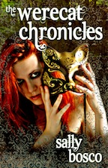
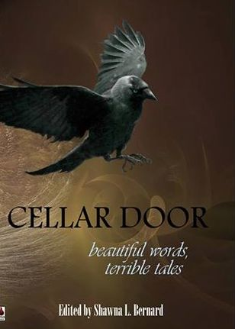
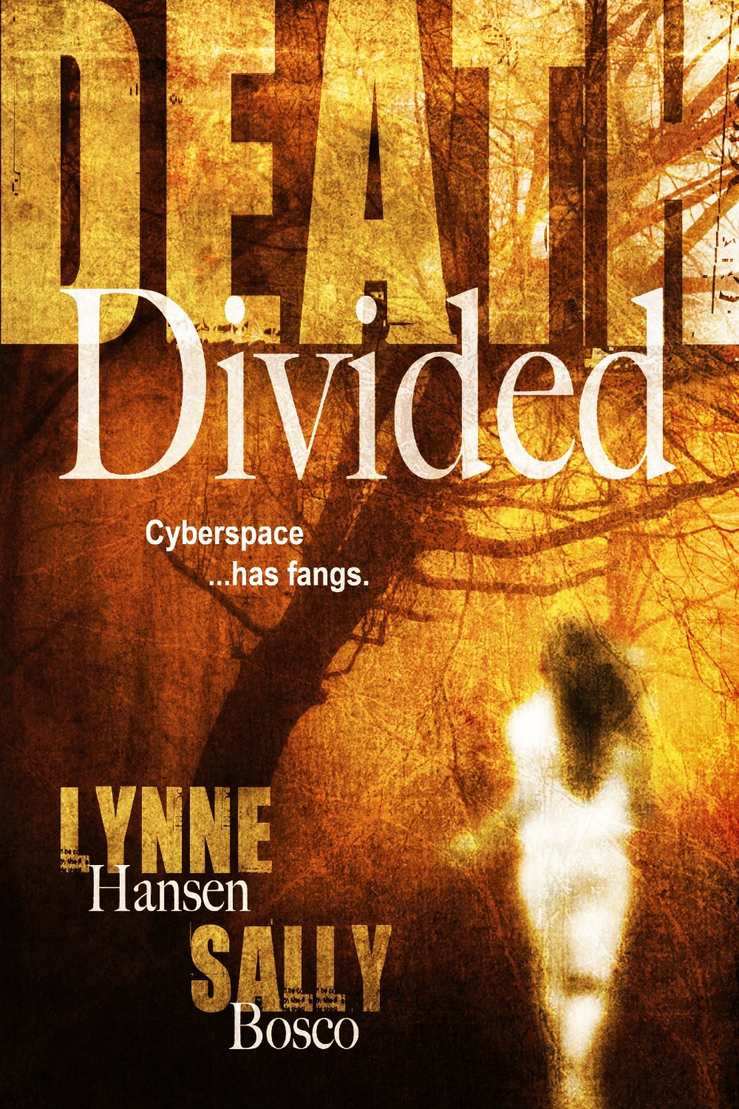
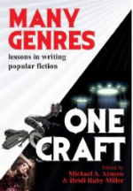
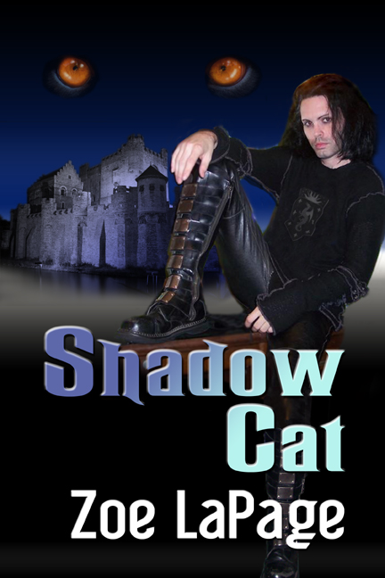
Thank you! SallyBosco.com

