Slide 1
Give Your Novel a Kick A** Story Title
Sally Bosco

Slide 2
Why it’s important to have a
Kick A** Title
Stand out in a slush pile
In our busy world, this may be the only thing the reader sees.
Catch a reader’s interest in a promo email or online preview
Pique the reader’s curiosity
Make your book sound better than it actually is

Slide 3
What we’re going to do in class:
Talk about the major way titles are chosen
Getting to the essence of your book
What to avoid: Pitfalls
Brainstorming
Exercise: Mind mapping your title

Slide 4
Major Ways Titles are Chosen
Titles Based on Theme:
What is your story about?
  The Hunger Games
  Memoirs of a Geisha
  Great Expectations
Central Character’s Name
  Dracula
  Rebecca
  Carrie
  Coralline
  Orlando

Slide 5
Major Ways Titles are Chosen
Central Character’s Occupation or Other Qualities
  The English Patient
  The Accidental Tourist
Setting (Place or Time)
  Middlemarch
  Lake Woebegone Days
  Mystic River
  Nineteen Eighty-Four
  Midnight in the Garden of Good and Evil

Slide 6
Major Ways Titles are Chosen
Concrete Object or Image
  The Bell Jar
  The Catcher in the Rye
  The Cider House Rules
Titles Inspired by Songs
      Norwegian Wood
      Go Tell it on the Mountain
      The Day the Music Died

Slide 7
Major Ways Titles are Chosen
A Popular Expression
  Something's Gotta Give
  The Usual Suspects
  The Whole Nine Yards
A Play on Words
  The Cancelled Czech
  You Only Live Twice
  Live and Let Die
  Are You There, Vodka? It's Me, Chelsea
  The Liar, the Bitch and the Wardrobe

Slide 8
Major Ways Titles are Chosen
A Possessive
  Portnoy's Complaint
  Angela's Ashes
  Charlotte's Web
Hidden Meaning
  The Green Mile
  Rain Man
  Atlas Shrugged
  Catch-22

Slide 9
Major Ways Titles are Chosen
The Novel Overall
  About a Boy
  A Month in the Country
  The World According to Garp
Contrasting Ideas
  I have no Mouth and I Must Scream
  Eyes Wide Shut
Mash-ups
  Pride and Prejudice and Zombies
  Warlock Holmes, Android Karenina

Slide 10
Major Ways Titles are Chosen
Double Meaning
  Generation Loss
  Middlesex
  Ender’s Game
Metaphor from the book
  Valley of the Dolls, Luck
  Death at the Edge of the World
  Clockwork Orange

Slide 11
Major Ways Titles are Chosen
Poetic-sounding line with relevance to the book
  Through Her Eyes
  This World We Live In
  Under the Never Sky
Quote from the Manuscript
  To Kill a Mockingbird
  Sleepless in Seattle
  A Room with a View

Slide 12
Major Ways Titles are Chosen
Famous Quotations
      I Sing the Body Electric: Ray Bradbury
      From: Leaves of Grass, Walt Whitman
      Of Human Bondage: W. Somerset Maugham From: Ethics, Baruch Spinoza
      As I Lay Dying: William Faulkner
      From: The Odyssey, Homer
      Blithe Spirit: Noël Coward
      From: To a Skylark, Percy Shelley
      Brave New World: Aldous Huxley
      From: The Tempest, William Shakespeare

Slide 13
Major Ways Titles are Chosen
"Trademark" Titles
  Janet Evanovich uses numbers: One for the Money, Two for the Dough, Three to Get Deadly, Four to Score.
  Sue Grafton uses letters of the alphabet: A is for Alibi, B is for Burglar, C is for Corpse, D is for Deadbeat.
  James Patterson chooses nursery rhymes: Roses are Red, Jack and Jill, Three Blind Mice, Along Came a Spider.

Slide 14
Major Ways Titles are Chosen
Series Titles
  The Girl with the Dragon Tattoo, The Girl Who Played with Fire, the Girl Who Kicked the Hornet’s Nest (Stieg Larsson)
  Divergent, Insurgent, Allegiant (Veronica Roth)
  Childhood, Boyhood, and Youth (Tolstoy)
  Shiver, Linger, Forever (Maggie Stiefvater’s)

Slide 15
Getting to the essence of your book
Things to help you arrive at a meaningful title:
Ask the simple question:
“What is my book really about?”
The Twist: Take your subject and transform it to add intrigue, give it a pleasing sound, and make it more unique.

Slide 16
Getting to the essence of your book
Add Perspective: If your subject is a flawed character, use a self-description that emphasizes their flaws.
Ask how a particular character would feel about your subject, then restate your title through that emotional filter: A Mother No More
Ask “when” or “where” about your subject, and use the answer to create an indirect reference instead of a direct one.

Slide 17
Getting to the essence of your book
  Identify a unique point of perspective in your book.
  Add Imagery, metaphor, or emotion
  Use a visual description from your manuscript.
  Consider the feelings or aspirations of a particular character toward your subject.
  Use dialogue from your Manuscript.
  Combine two ideas that gain extra meaning when used together

Slide 18
Getting to the essence of your book
Add Intrigue or Curiosity
      Create a question
      Create an implied question by including the name of something unfamiliar: (what is) The Da Vinci Code, (who is) The Great Gatsby
      Express the central theme as a dilemma: Honor or Survival
Add Comparison or Juxtaposition
      War and Peace
      Love in the Days of Cholera

Slide 19
What to Avoid: Pitfalls
Fads and overused words:
  After Gone Girl there has been a rash of books with “Girl” in the title.
    Girl on the Train, The Girl Before, All the Missing Girls
    Words like haunted, hunted, fire, forever, shadow, chosen, etc. are used over, and over.
Cliché genre titles
Titles that are dull (The House, The Tree)
Titles that are too “on the nose.”

Slide 20
What to Avoid: Pitfalls
Too long and complicated
Give away spoilers
Hard to pronounce or remember (long fantasy names)
No connection to the story, or connection is sketchy at best.
Sounds too much like other titles

Slide 21
What to Avoid: Pitfalls
Don’t accidentally create a mondegreen.
  “There's a bathroom on the right” and
  “There's a bad moon on the rise”
  Creedence Clearwater Revival
  “'Scuse me while I kiss this guy” and
  “'Scuse me while I kiss the sky” Jimi Hendri

Slide 22
Brainstorming Worksheet
List any important items.
      Does your story revolve around an object like a sword or pendant?
Write down who your protagonist IS.
      Is it an assassin, a nun, a serial killer, a werecat?
Write down important concepts, themes, and metaphors.
Write a summary of your story (3 or 4 words)

Slide 23
Brainstorming Worksheet
List words/phrases that could possibly serve as titles or pieces of titles.
  Write down every single thought, feeling, image, color, adjective, verb, noun, name, word that comes to your head.
Use thesaurus.com

Slide 24
Brainstorming Worksheet
The Open Loop - The title has a missing piece, and the agent, editor, or book lover wants to read more to attain closure or solve the mystery.
  The Things They Carried
  13 Reasons Why
  Everything I Never Told You

Slide 25
Mind Mapping Your Title: Names
Characters: protagonist, antagonist, any major figures
      Carrie, Oliver Twist
Titles, relationships or jobs
      Time Traveler’s Wife
Setting(s)
      Wuthering Heights, Miss Peregrine’s Home for Peculiar Children
Time period:
      1984, 11/22/63 (Stephen King)
Anything integral to the plot, like key objectives or events.
      The Hunger Games

Slide 26
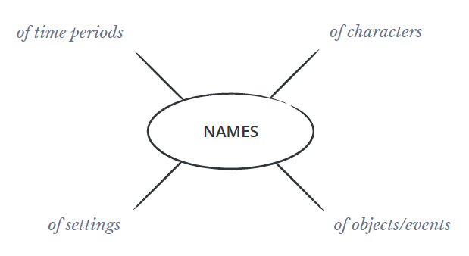
Mind Mapping Your Title: Names

Slide 27
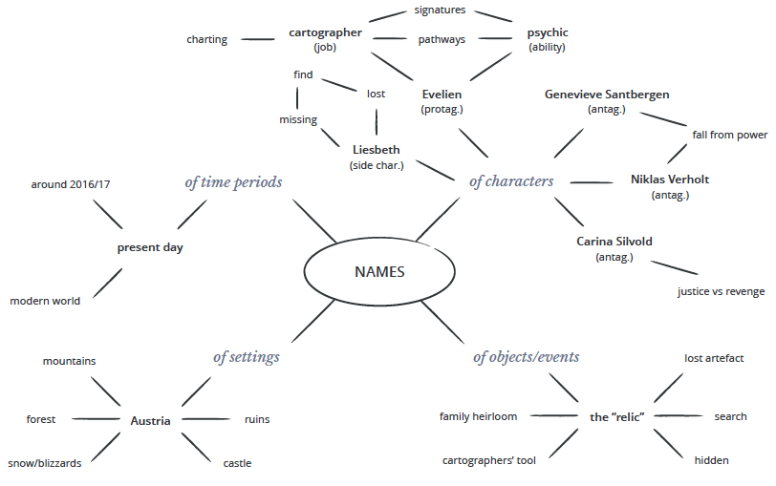
Mind Mapping Your Title: Names

Slide 28
Mind Mapping Your Title: Story Elements
Any major themes in your story
      War and Peace, Atonement
Driving character goals or motivations
      Keeping Faith by Jodi Picoult
Conflicts crucial to the plot
  A Prayer for Owen Meany
Terms related to the story’s genre
  How to Train Your Dragon

Slide 29
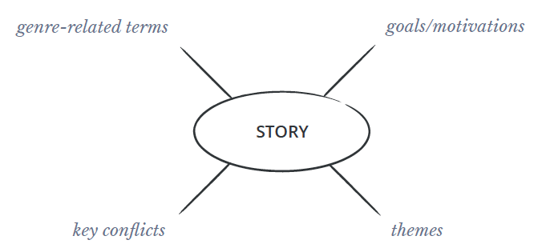
Mind Mapping Your Title: Story Elements

Slide 30
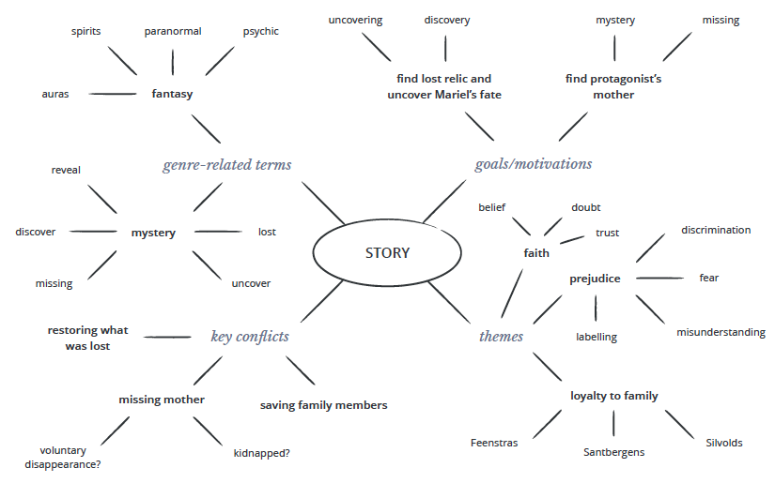
Mind Mapping Your Title: Story Elements

Slide 31
Mind Mapping Your Title: Meaningful
Elements that are pivotal to the story
    Breakfast at Tiffany’s, Crash
Double meanings/open question/mystery
    The Forest of Hands and Teeth
    Wide Sargasso Sea
Dialogue/narrative/quotes from the book
    Oh, the Places You’ll Go
    I am an Invisible Man
Meaningful words or phrases that don’t fit other categories.

Slide 32
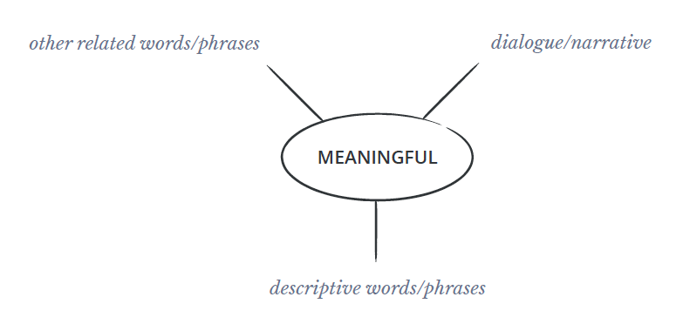
Mind Mapping Your Title: Meaningful

Slide 33
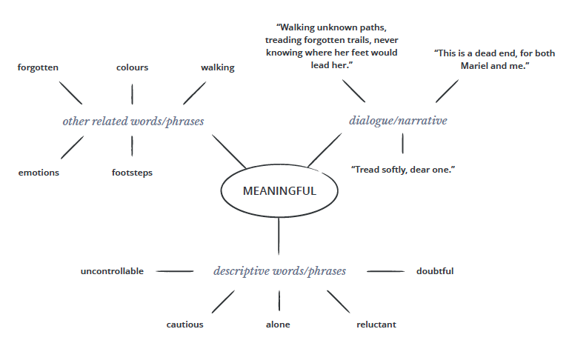
Mind Mapping Your Title: Meaningful

Slide 34
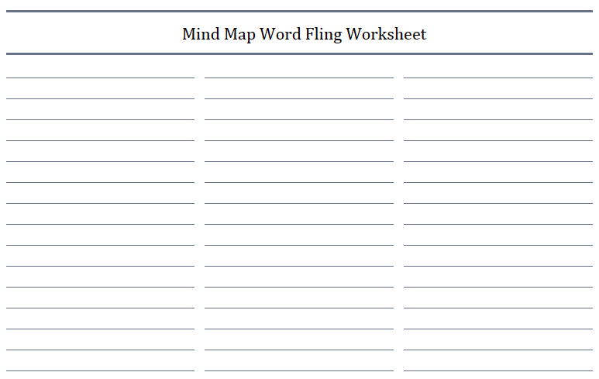
Mind Mapping Your Title

Slide 35
Mind Mapping Your Title
Narrow the words down and rearrange them.
Keep in mind:
  The style of your title will affect your readers’ expectations so keep your writing style consistent from title to story.
  Genre can also affect title conventions.
  If your book is part of a series, consider whether you’ll make the titles for all the books related somehow.

Slide 36
Mind Mapping Your Title
List ten possible titles…

Slide 37
Mind Mapping Your Title
And the winner is…

Slide 38
Conclusion:
Your title is the first (and maybe only) chance you get to grab the reader
Give your book a title that truly reflects the tone and quality of your work.
Choose a title that resonates with the reader.
Give your book a title that sets it apart from the pack.

Slide 39


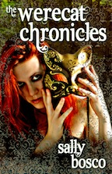

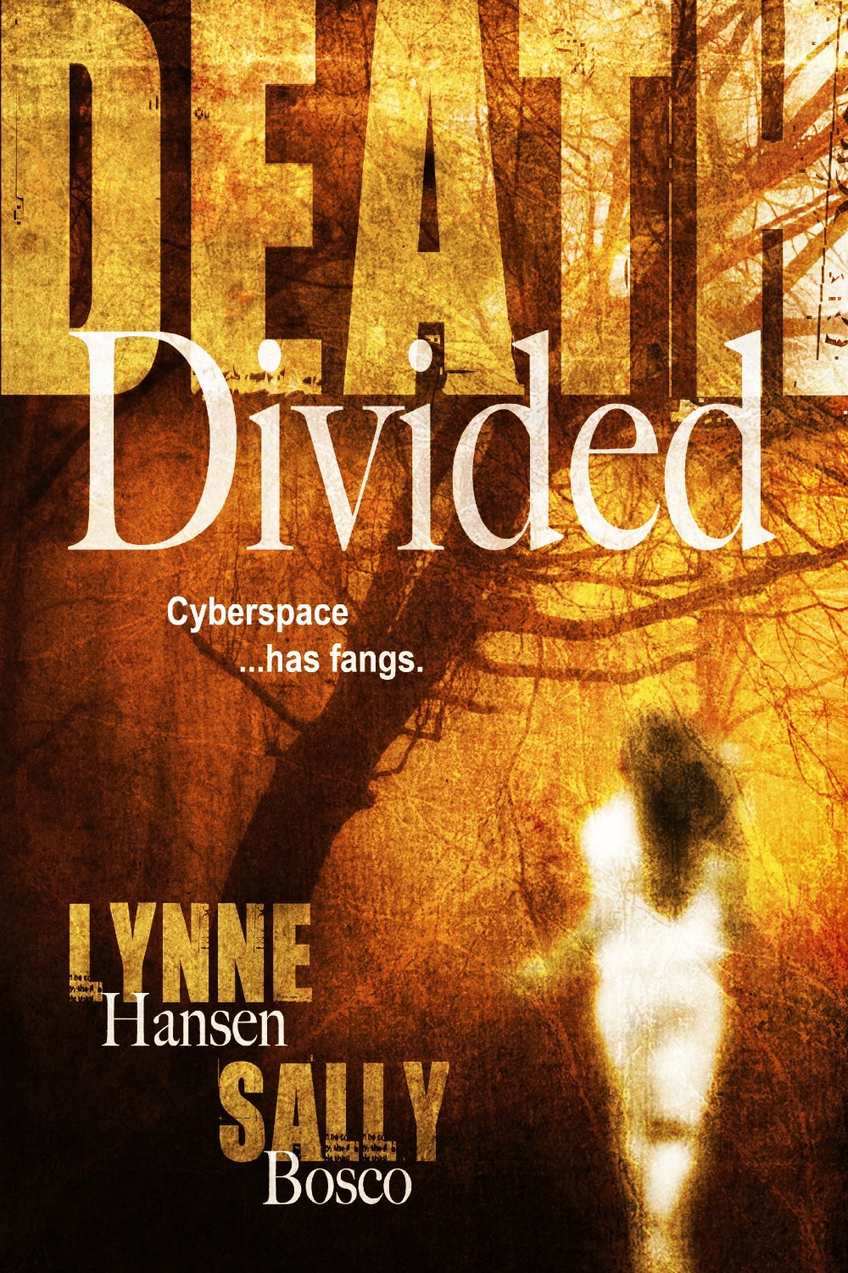
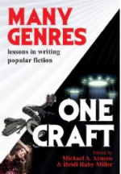

Thank you! SallyBosco.com

