Slide 1
Using the Emotional Wound to Bring Your Writing to the Next Level
Sally Bosco
You can access the files used in this class at: SallyBosco.com Click on the Classes tab.

Slide 2

All fiction is about a wound colliding with a core problem in need of resolution.
2

Slide 3

What is an emotional wound?
A wound is a negative past experience or series of experiences that causes extensive emotional pain. It could be a devastating moment, repeated traumatic episodes, or an ongoing damaging situation.
3

Slide 4

However…
An emotional wound is so much more than an uncomfortable memory: it is a past traumatic moment that generates fear so deep it changes a person’s behavior and beliefs, often in negative, unhealthy ways.
4

Slide 5
Why this is personal to me…
5

Slide 6
Why the emotional wound is essential:
It connects readers with complex characters who remind them of themselves, which results in story magic.
Creating true-to-life mirrors with our fiction is the key to drawing readers in.
Wounds are something we all share because life can be a painful teacher.
6

Slide 7
Wounds can present in a variety of ways.
They can come from a single traumatic event or from repeated episodes of trauma, like a string of toxic relationships.
Wounds may also result from a detrimental ongoing situation, such as childhood neglect or growing up in a violent cult.
7

Slide 8
The wound’s dark passenger: The Lie
This lie is a conclusion reached through flawed logic. Caught in a vulnerable state, the character tries to understand or rationalize her painful experience, only to falsely conclude that fault somehow lies within.
8

Slide 9
The lie is tied to disempowering beliefs (that the character is unworthy, incompetent, naïve, defective, or lacks value), a path of destruction is left in its wake.
Once a lie forms, it’s like a fungus releasing toxic spores. The false belief seeds itself deep into the character, damaging his self-esteem, sabotaging his confidence, and creating fear.
9

Slide 10
The emotional wound causes fear that goes bone deep.
One of the most significant (and damaging) results of this type of fear taking the driver’s seat is the construction of EMOTIONAL SHIELDING, which the character erects as a barrier between him and the people or situations that could lead to more hurt.
10

Slide 11
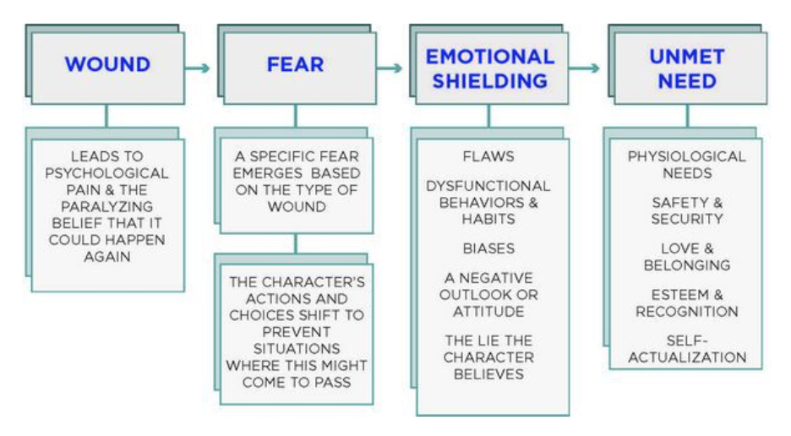
Because the wound is never allowed to heal, fear of what could happen again steers the character’s actions and choices at each moment.
11

Slide 12

How to Brainstorm your Character’s Wound:
General areas to brainstorm:
Past influencers
Unpleasant memories
Personality flaws
Fears
Secrets
Insecurities
Biases or jaded outlook
Overcompensation
Dysfunction
Unmet needs
See questions on Brainstorming the Emotional Wound - Worksheet.
See worksheet: Brainstorming the Emotional Wound
Con’t.
12

Slide 13
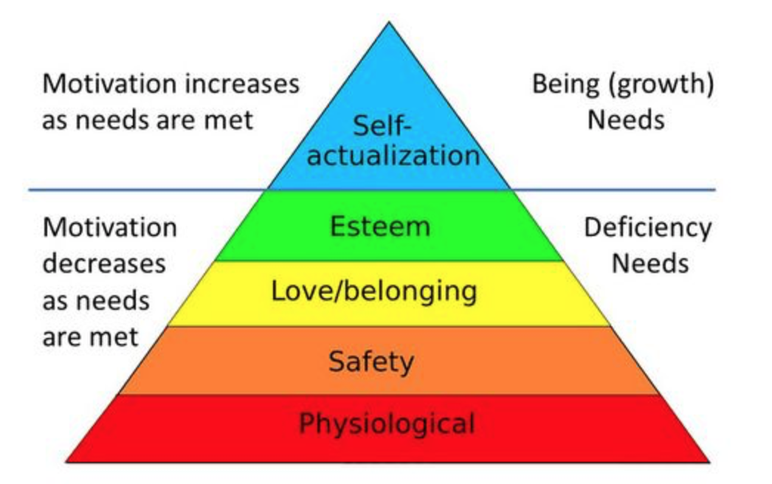
How to Brainstorm your Character’s Wound: (con’t):
Unmet needs
    A quick scan of Maslow’s pyramid can reveal what’s missing from your character’s life, which can be a signpost for an emotional wound.
13

Slide 14
Wound Categories:
It can help to understand common areas of psychological damage.
Disabilities and disfigurement
Injustice and hardship
Failures and mistakes
Misplaced trust and betrayals
Crime and victimization
Traumatic events
Specific childhood wounds
14

Slide 15
How to Reveal the Wound in your Story
Once you determine your character’s wound, you have to figure out how to reveal it to your readers. Showing is always better than telling.
The big reveal
The big tease
The trail of breadcrumbs: leading the readers to the wounding event
Fear
Self-doubt
Overreactions and underreactions
Con’t.
15

Slide 16
How to Reveal the Wound in your Story: (con’t)
Triggers
Denied emotions
Obsessions
Dialogue and other characters
Setting interactions (props, symbols, locations, weather)
Defense mechanisms
16

Slide 17
Problems to Avoid in Revealing Your Character’s Wound:
Info dumps
Poorly staged flashbacks
Misused prologues
Wounds that aren’t credible
Wounds that resolve abruptly
17

Slide 18
How to Choose a Plot that Maximizes your Character’s Wound:
You have some idea of your character and some idea of your plot.
With your character’s wound in mind, choose a plot that makes life a living hell for her.
Example: Jack Torrance (The Shining)
Wound: Growing up with an abusive and alcoholic parent
Fear: That he will be just like his dad
Emotional Shielding: Jack is a recovering alcoholic with rage issues who. Though he recognizes his dead father’s negative influence over him, he doesn’t fully refute the resulting self-doubt, which undermine his efforts to become a better parent and husband.
Unmet Need: Ultimately, Jack is lacking Esteem and recognition because he
doesn’t respect himself. Though he finds redemption in the end, the
insecurity resulting from his wound eventually leads to his physical demise.
18
See worksheet: Integrating the Emotional Wound into Your Plot

Slide 19
Character Arc: An Internal Shift to Embrace Change
﻿Outer story vs. inner story
Two possible arcs:
Lack + emptiness leaves the character yearning for more. The rest of the story is about the pursuit of that unmet need by the character chasing a tangible goal that will fill it.
The character starts the story feeling satisfied and complete. Almost immediately, something is taken from him. The story then becomes about the character regaining what was lost.
19

Slide 20
The Driving Components of the Character Arc:
The following four pieces make up the core of storytelling. Take one away and what remains is diminished, or the story as a whole may fail to work.
Inner Motivation: An unmet or missing need that creates a deep longing or sense or urgency.
Outer Motivation: A tangible goal that represents the fulfillment of this need.
Outer Conflict: People or forces that oppose the character’s mission.
Inner Conflict: Any fears, flaws, wounds, or misbeliefs that block personal growth and diminish the character’s self-worth.
20

Slide 21
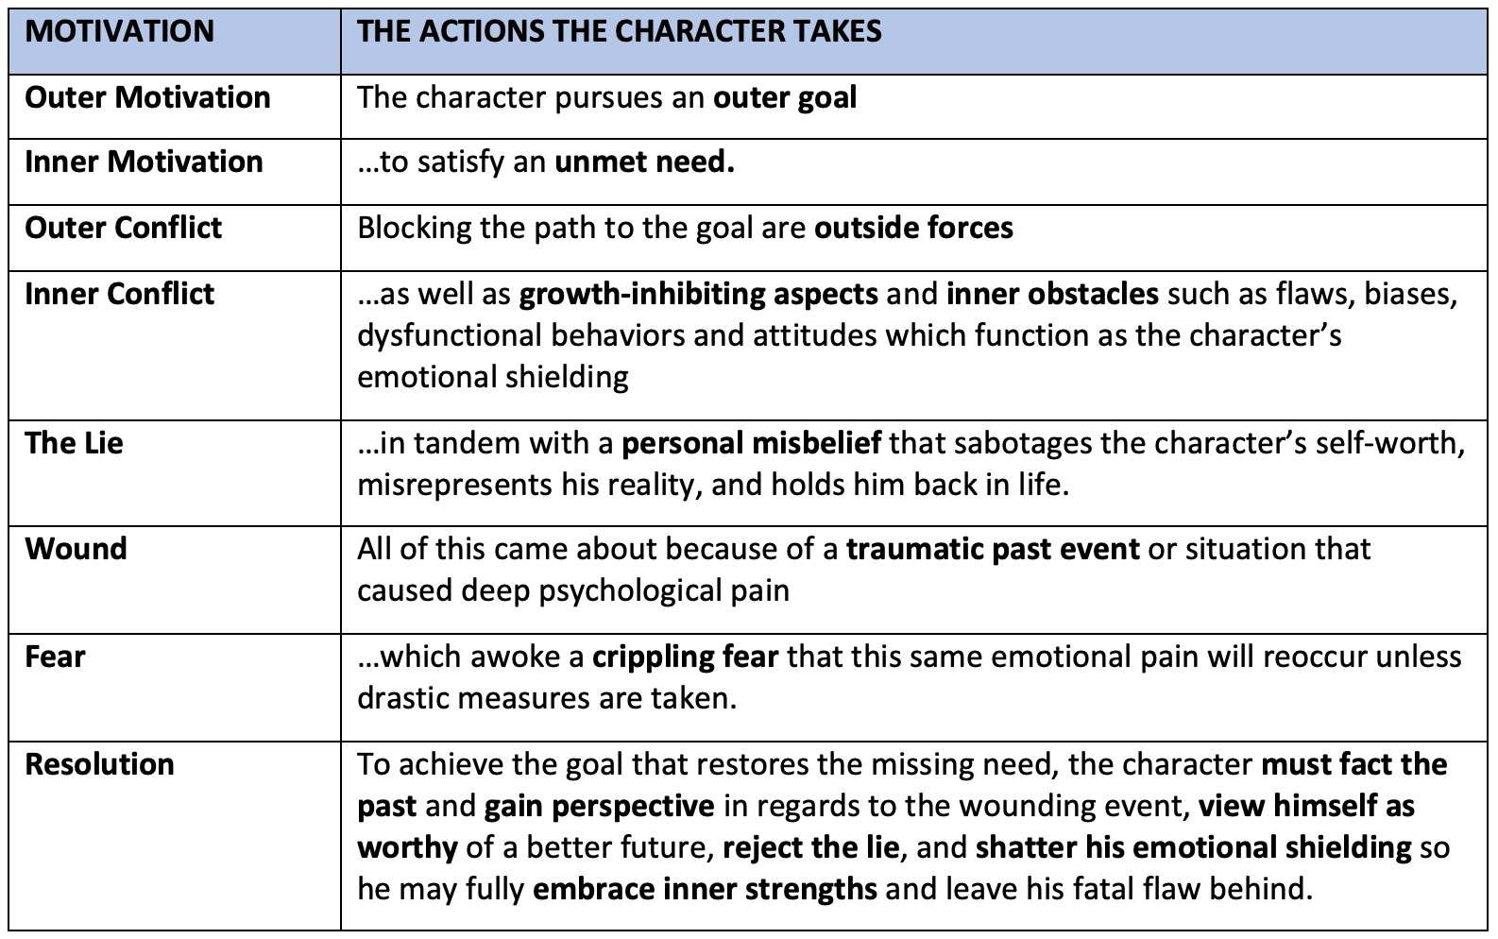
The Character Arc Diagram
(considering the emotional wound):
21

Slide 22
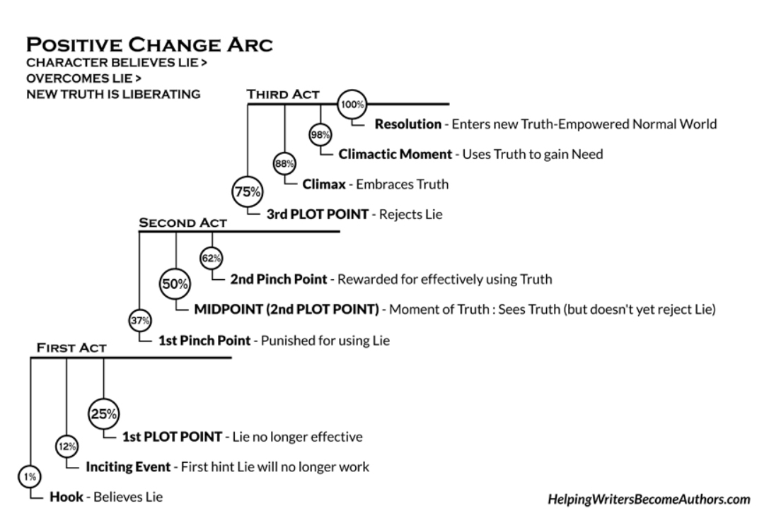
Problems to Avoid:
Info dumps
Poorly staged flashbacks
Misused prologues
Wounds that aren’t credible
Wounds that resolve abruptly
22

Slide 23
Exercises…
Brainstorming the Emotional Wound - Worksheet
Integrating the Emotional Wound into your Plot - Worksheet
23

Slide 24
What did you learn from the exercises?
What did you learn about your character’s emotional wound?
What is the lie your character is telling herself?
What emotional shielding does she use?
Did you ﻿find a plot that resonates with the character’s wound?
What is your character’s dark moment?
What unmet need drives her towards her goal?
24

Slide 25
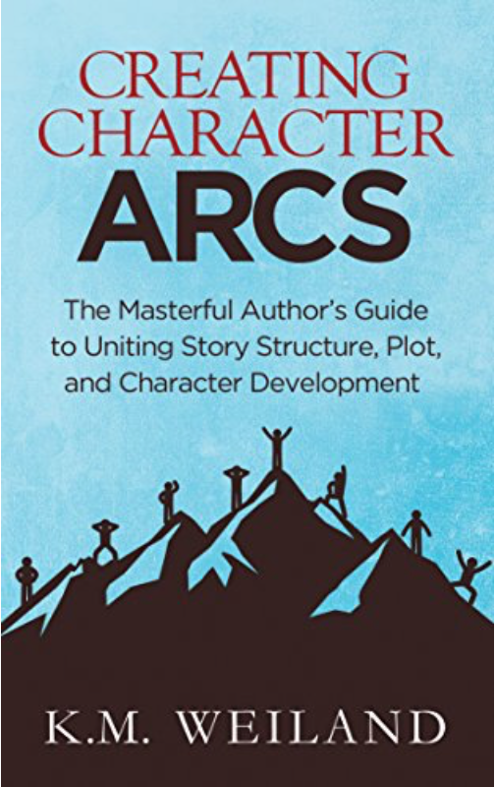
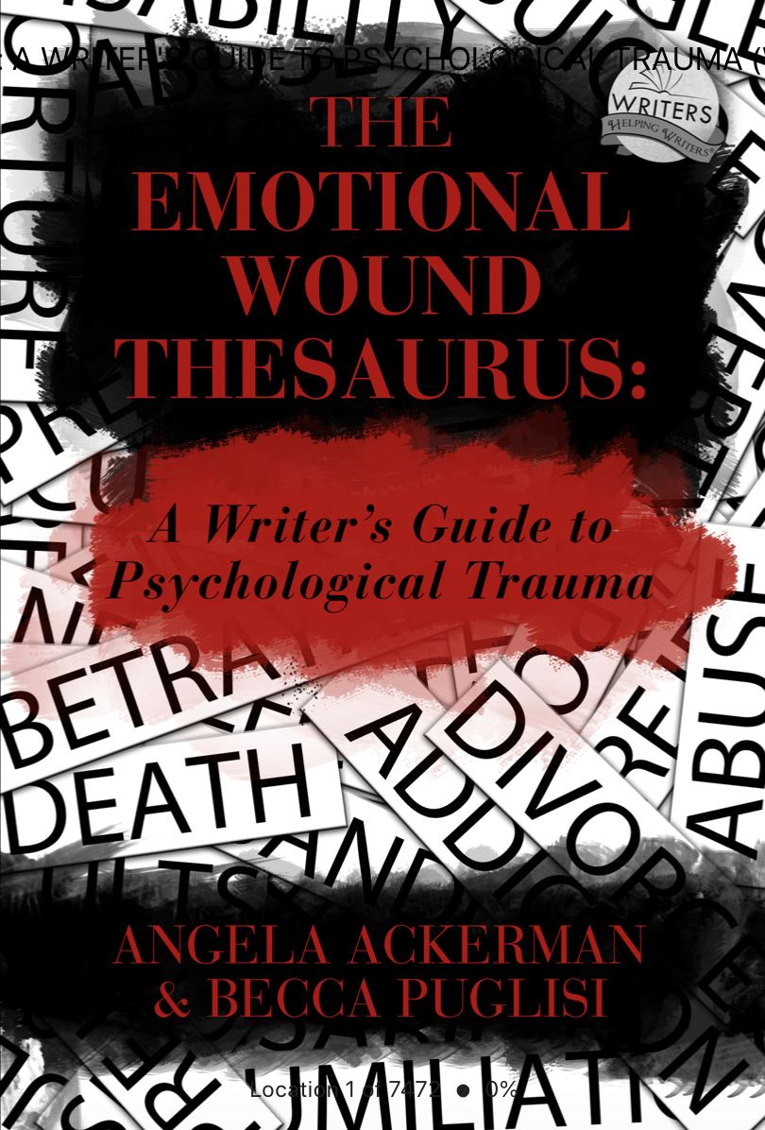


References:
The Emotional Wound Thesaurus, by Angela Ackerman & Becca Puglisi
Creating Character Arcs, by K.M. Weiland
Goal, Motivation, and Conflict, by Debra Dixon
25

Slide 26
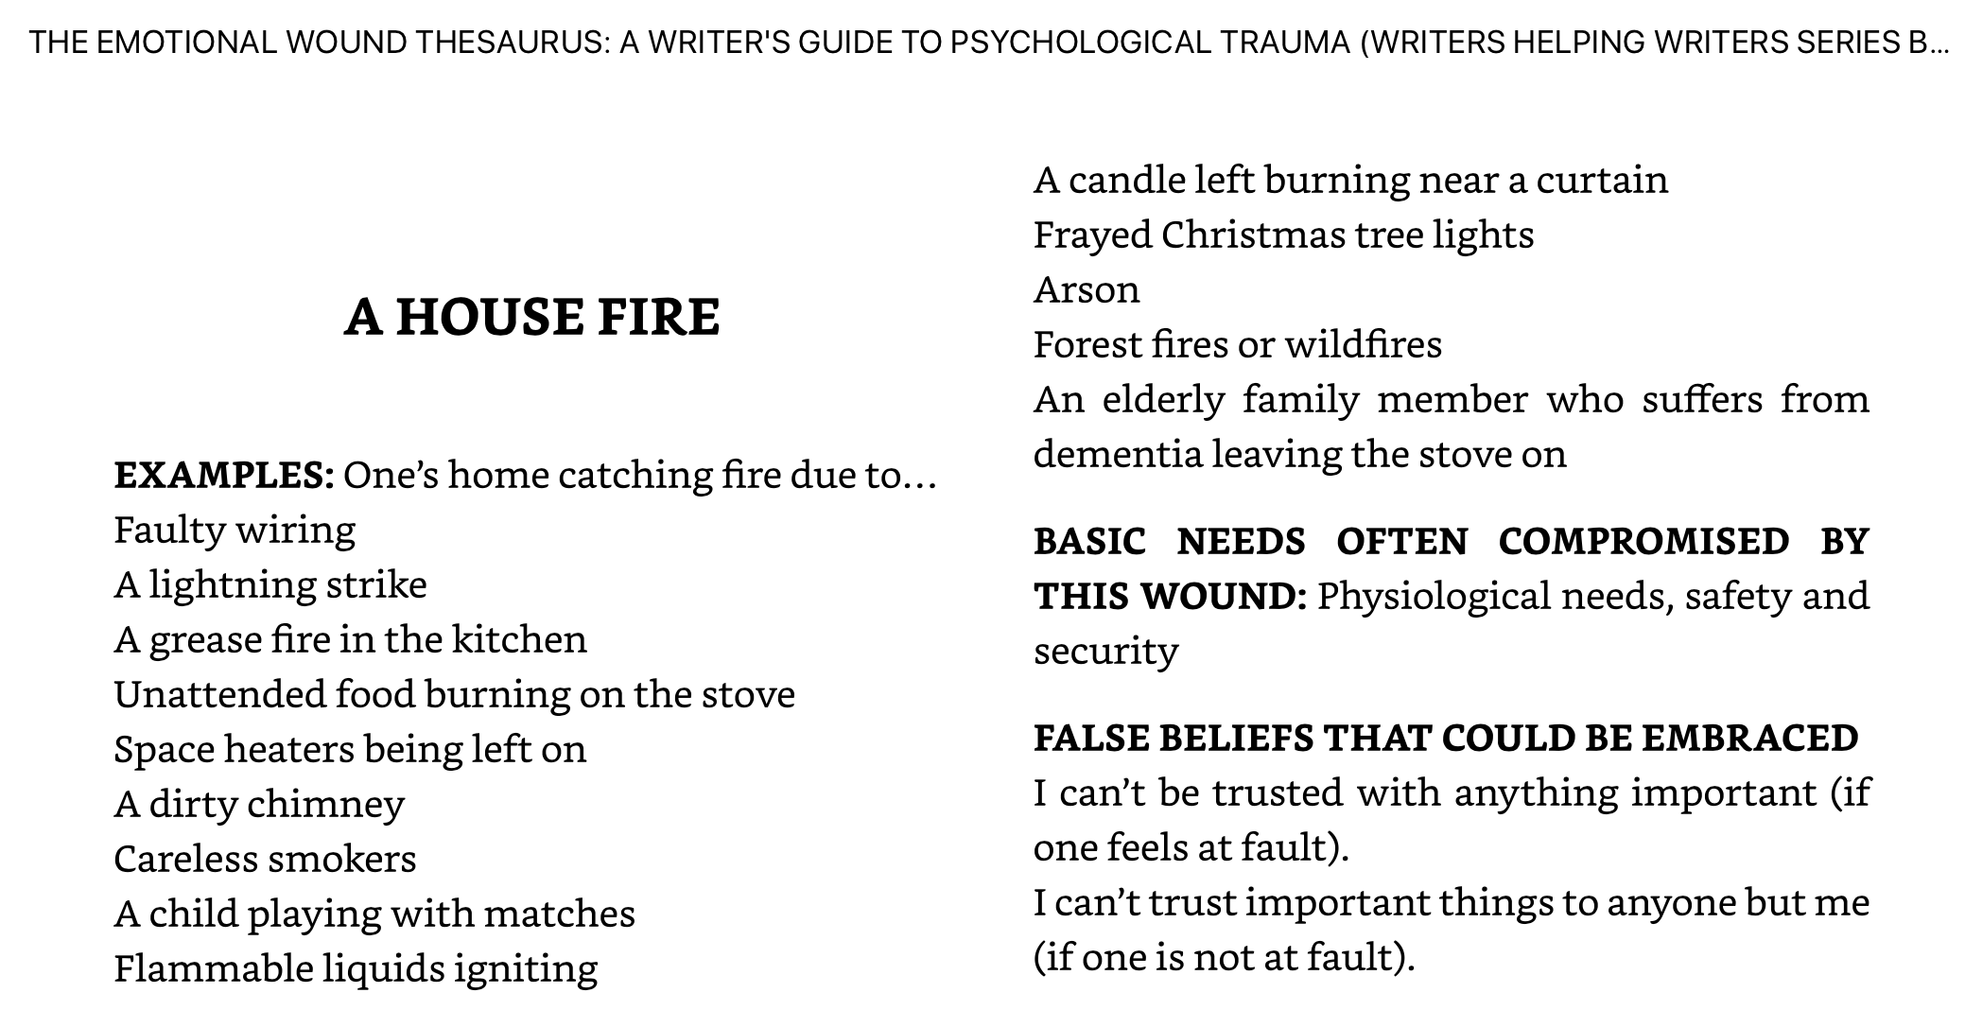
The Emotional Wound Thesaurus, has a thesaurus of wounds, their associated fears, personality traits, etc.
26

Slide 27

THANK YOU!
Sally Bosco
Website:
SallyBosco.com

