Slide 1
Using Microtension to Up Your Writing Game
Sally Bosco
You can access the files used in this class at: SallyBosco.com Click on the Classes tab.

Slide 2
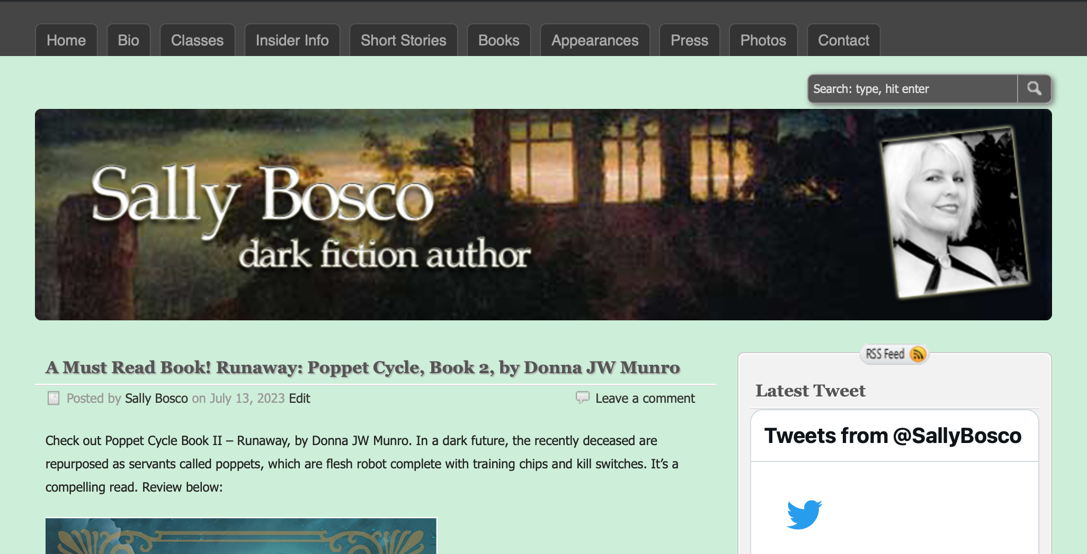
SallyBosco.com
2

Slide 3
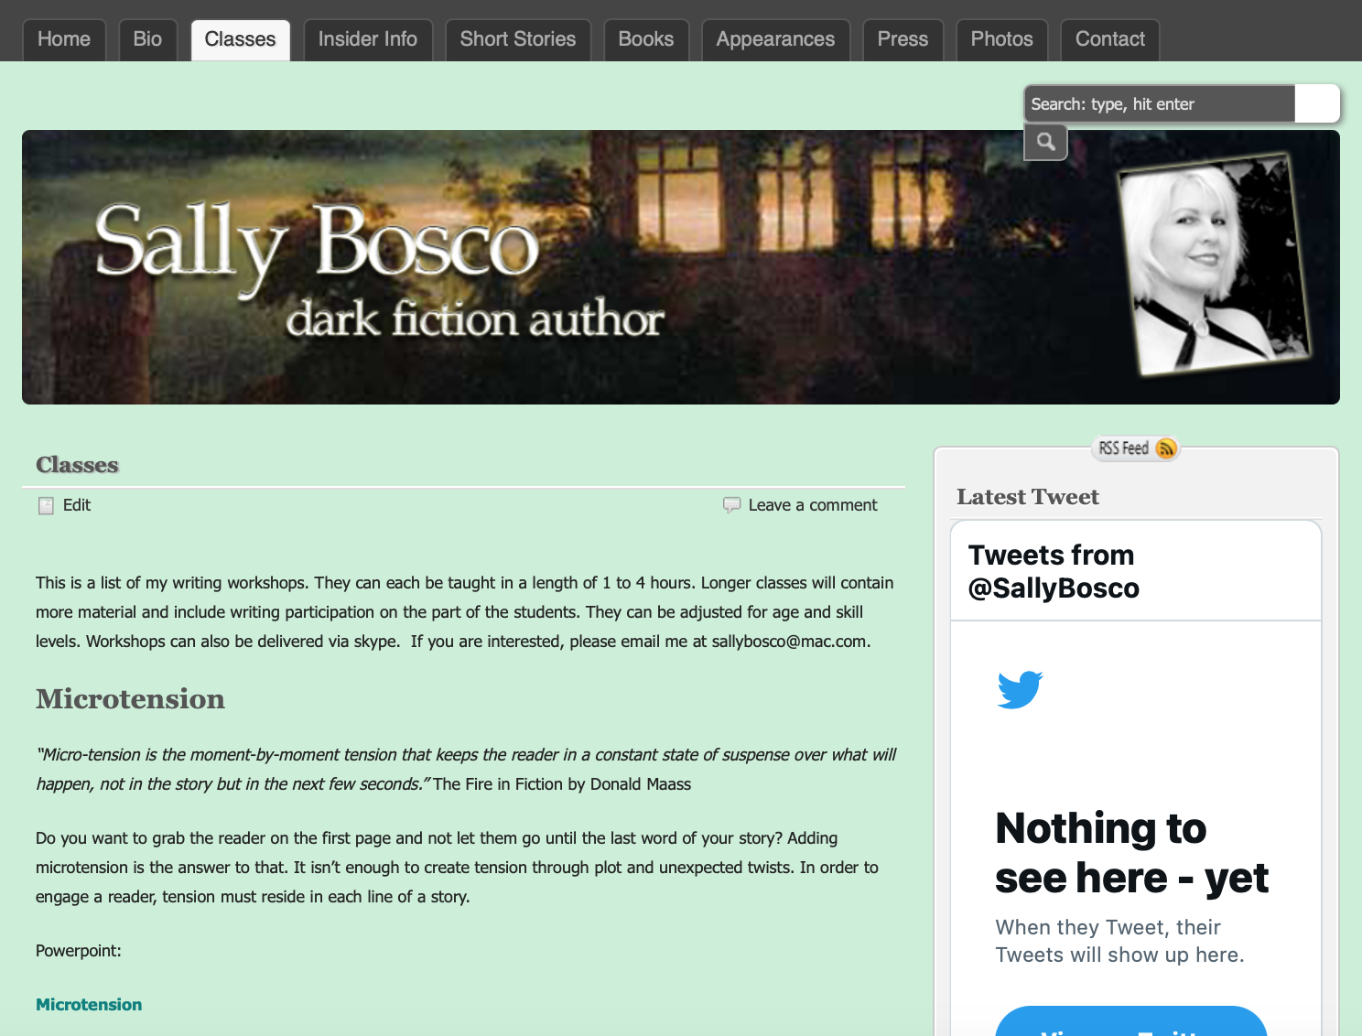

SallyBosco.com

Slide 4
“Micro-tension is the moment-by-moment tension that keeps the reader in a constant state of suspense over what will happen, not in the story but in the next few seconds.”
Donald Maass, The Fire in Fiction

Slide 5

Microtension

Slide 6

Today we’ll talk about:
Creating Tension in Dialogue, Action and Exposition
Using Opposition to Create Tension
Layering Different Types of Tension
Sustaining Tension Throughout Your Story
Using Cognitive Dissonance
Avoiding Low Tension Traps

Slide 7
What is an Microtension?
The tension and conflict that occurs on a line-by-line basis throughout your writing.
Good microtension can be found in every page, in dialogue, actions, setting, and more.
A juxtaposition of what is really happening in the scene with what is described by the point of view character.

Slide 8

Macro vs. Micro Tension?
Macro is:
Big plot twists, reversals and surprises
High drama, high conflict, and even high stakes
A character’s big goals
Micro is:
Tension woven throughout your story
It involves much subtler, indirect cues.

Slide 9
Macro Tension:
Has great potential for sparking emotional response in readers.
But …
It can’t be sustained at full intensity through the course of the story

Slide 10
What are the elements of microtension, and how do I use them?
Conflicting feelings
Element of surprise
Sudden change in emotion
When things feel off
Create series of steps which leads your character toward that ultimate goal.
Create doubt and skepticism

Slide 11
Creating Tension in Dialogue, Action and Exposition
What keeps us reading all the way?
It's not high action. It's not throwing in sex and violence.
It's microtension.
When you don’t have microtension, you're slowly losing your reader.
Microtension comes from conflicting emotions.

Slide 12

Dialogue

Slide 13
Creating Microtension in Dialogue:
There needs to be a tug-of-war between the talkers.
Check every conversation in your story. Is the dialogue only about the circumstances?
If so, that is dangerous. Instead, find the emotional friction between the speakers.
Or externalize your main character's inner conflicts.

Slide 14
Use Contradiction in Dialogue:
Inner conflict from the character
Make the character feel conflicted about what they’re saying.
One character’s “reluctance to accept” something about the exchange, the words, or the other character.
Make one character uncertain about or suspiciousness of the other character.

Slide 15
Use Contradiction in Dialogue: (con’t)
Put one character on the defensive, even if it doesn’t seem provoked.
Or put one character on the offensive, make them aggressive, even when it doesn’t seem necessary.
Find the emotional friction between the speakers. True tension in dialogue comes not from what is being said, but from inside those who are saying it.
Subtext: What the person says vs. what she means.

Slide 16
Example for Microtension in Dialogue: The Red Tree by Caitlin R. Kiernan
“Thanks,” I said, and Amanda Tyrell just smiled and shrugged and sat down again, but this time she sat down quite a bit closer to me than before. And then I broached The Question, because, even sober, I’d made The Embarrassing Mistake too many times in the past. Never assume. Never, ever assume.
“You are a lesbian,” I said, and that earned more laughter.
“Is that an inquiry or a command?”
“That’s a question,” I said, sipping my beer, “because I think I’m getting signals here, and I don’t want to make a goddamn fool out of myself if you’re straight.”
She stared at me a moment, just long enough, I think, that she knew I’d be getting nervous. And then she nodded.
“Guilty as charged,” she told me. “A lesbian is what I am. Last time I screwed a guy—first and last time, by the way—I was fourteen.”
“Well, then, that’s a relief,” and I laughed, probably for the first time since we’d begun talking.
“But, I have a confession to make,” Amanda continued, so I’m thinking, yeah, here comes the other shoe. She’s in a relationship. Or she’s celibate, or I’m just not her type. Something of the sort surely, but then she says, “I haven’t actually read The Ark of Poseidon. Or anything else you’ve ever written.”
I probably laughed very loud then. Maybe beer even squirted out my nostrils. Maybe my sinuses burned all night.
“I got those questions about your book from Tracy,” and she pointed into the constantly shifting crush of bodies. Tracy, by the way, was the girl in the band, whom I’d been dating back when I was writing The Ark of Poseidon, and she’d even helped out proofreading the galley pages. I felt set up and relieved at the same time.
“Cute,” I told her, though I didn’t think it the least bit cute. Mostly, I was wondering what the hell Tracy was playing at, if she thought I was so pathetic I needed her sending fish my way (which, at that point, I probably was), or if she was just messing with my head.
“You think so?”
“No, but it’s more pleasant than if I tell you what I’m really feeling right now.”
Her eyes dimmed and her smile faded a bit then.
“Well, I hope I haven’t pissed you off,” Amanda said, after a minute or so.
“Nah, you haven’t pissed me off,” I assured her. “When you’re a writer, you learn to live by dirty tricks, or you don’t last very long.”
“You think that was a dirty trick?”
“Near enough,” I replied, and then, changing the subject, because I was still a lot hornier than I was angry, I said, “So, it depends on what I consider art. Whether or not you’re an artist.”

Slide 17

Action

Slide 18
Microtension in Action:
High action immediately benefits from having torn emotion folded in.
Ticking clock. What effect is that having on the character?
Tension in action comes not from the action itself but from inside the point-of-view character.
Violent action doesn’t cause tension, but anticipation, expectation, uncertainty, and buildup do.
Emotions are needed to give action force.

Slide 19
Use Contradiction in Action:
Maas says, “tension in action comes not from the action itself but from inside the point of view character experiencing it.”
Choose and describe action in a way that suggests or foreshadows sinister things to come.
Brainstorm ways the scene action can play out. Is there something that suggests the opposite of what will actually happen?

Slide 20
Example of Microtension in Action: The Fifth Season by N.K. Jemisin
LET’S START WITH THE END of the world, why don’t we? Get it over with and move on to more interesting things.
First, a personal ending. There is a thing she will think over and over in the days to come, as she imagines how her son died and tries to make sense of something so innately senseless. She will cover Uche’s broken little body with a blanket—except his face, because he is afraid of the dark—and she will sit beside it numb, and she will pay no attention to the world that is ending outside. The world has already ended within her, and neither ending is for the first time. She’s old hat at this by now.
What she thinks then, and thereafter, is: But he was free.
And it is her bitter, weary self that answers this almost-question every time her bewildered, shocked self manages to produce it: He wasn’t. Not really.
But now he will be.
16

Slide 21

Exposition

Slide 22
Microtension in Exposition
Much exposition is so boring that we skip it.
It’s a mistake to include too much of what a character is thinking and feeling, unless the focus is on contradiction.
The interior lives of the characters need to create constant tension.
Don’t restate the obvious. Create conflicted thoughts within your protagonist.

Slide 23
Use Contradiction in Exposition:
Donald Maass says, “true tension in exposition comes not from circular worry or repetitive turmoil; it springs from emotions in conflict and ideas at war.”
Use conflicting feelings, ideas, concepts, goals, impulses, dilemmas, etc.
Overemphasize one emotion to make the reader anticipate that actions producing the opposite emotion will actually play out in the story.

Slide 24
Example of microtension in exposition: We Were Liars by E. Lockhart
WELCOME TO THE beautiful Sinclair family.
No one is a criminal.
No one is an addict.
No one is a failure.
The Sinclairs are athletic, tall, and handsome. We are old-money Democrats. Our smiles are wide, our chins square, and our tennis serves aggressive.
It doesn’t matter if divorce shreds the muscles of our hearts so that they will hardly beat without a struggle. It doesn’t matter if trust-fund money is running out; if credit card bills go unpaid on the kitchen counter. It doesn’t matter if there’s a cluster of pill bottles on the bedside table.
It doesn’t matter if one of us is desperately, desperately in love.
So much in love that equally desperate measures must be taken.
We are Sinclairs.
No one is needy.
No one is wrong.
We live, at least in the summertime, on a private island off the coast of Massachusetts.
Perhaps that is all you need to know.

Slide 25
Microtension in Setting
Put your characters in opposition to nature. Darkness signals trouble.
Place characters in an unfamiliar setting that causes uncertainty
Use irony.
    Lemony Snicket: An Unauthorized Autobiography by Lemony Snicket
    “Today was a very cold and bitter day, as cold and bitter as a cup of hot chocolate if the cup of hot chocolate had vinegar added to it and were placed in a refrigerator for several hours.”.
        Use contrast.
        In Harry Potter, the contrast that happens when Harry travels from the ordinary world to the magical Hogwarts.

Slide 26
Use Contradiction in Setting:
Have the setting mirror the character’s inner tension.
Put the character’s attitude toward the setting in conflict with the setting’s appearance. For example, the place is beautiful, but has bad memories or makes her anxious.
Is there something about the setting that the character doesn’t know and yet wants or needs to know?
Give a character a conflicted attitude toward another person, place, or thing that’s being described.

Slide 27
Example of microtension in setting: Poisonous Garden by Sally Bosco
People swarmed around the entrance to the Cuban Club—some in Venetian masks, others in 1920s flapper outfits. One man leaned against a lamp post in a giant, pink bunny costume. I thought about how he must have been burning inside that outfit, just like my stomach burned thinking about going inside. I had high hopes for the evening, but fear threatened to torpedo my night.
* * *
The scent of the garden flowers, jasmine and camellia mostly, floated in through the open windows. We had a huge yard, big enough for me to have some privacy. This cottage was my parents’ concession to me, to be able to have one last summer of painting before I went off to college to become a business major.

Slide 28
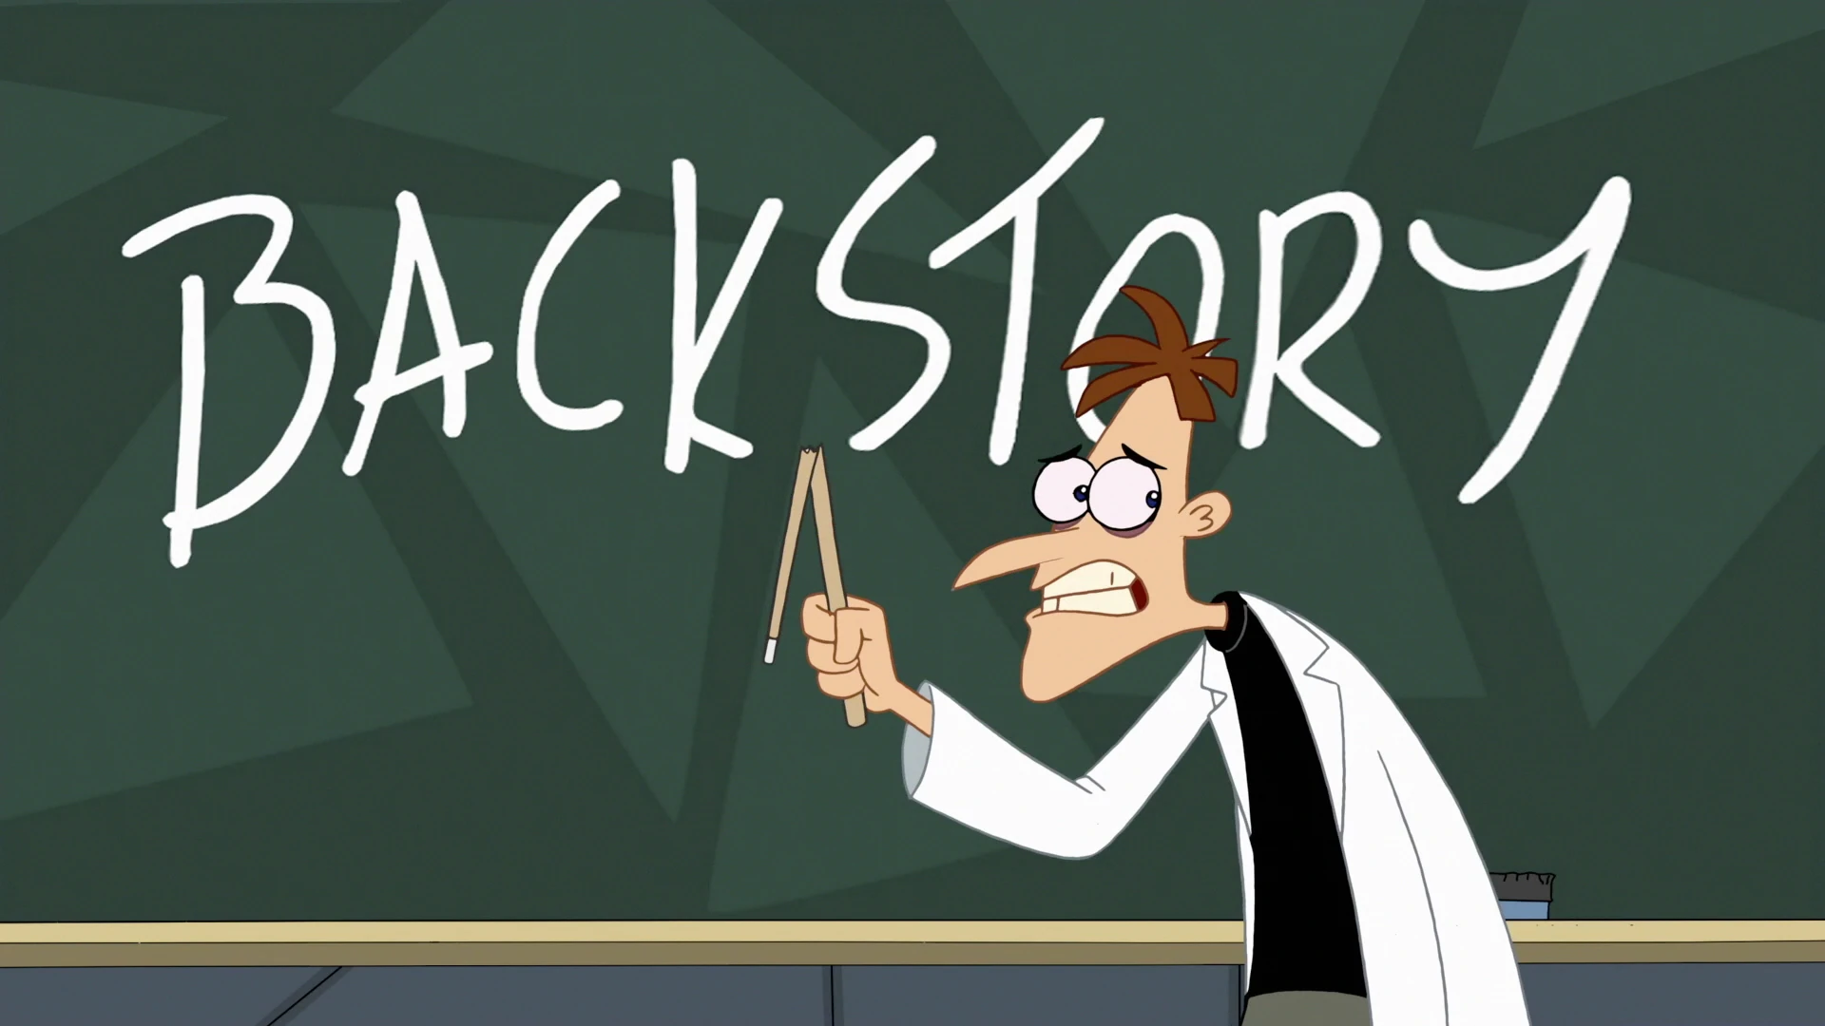

Slide 29
Use Microtension in Backstory:
Make Character anything but neutral about his past. He can be regretful, doubtful, overconfident . . . anything but neutral.
Give Character long-held desires with no way to fulfill them.
Use the past to stir up conflict in the present. Buttons to push. Problems to solve. Desires to forget or fulfill.
Describe the character’s wound in a phrase and brainstorm contradictions.

Slide 30
Example of microtension in backstory: Ancient Light by John Banville
BILLY GRAY WAS MY BEST FRIEND and I fell in love with his mother. Love may be too strong a word but I do not know a weaker one that will apply. All this happened half a century ago. I was fifteen and Mrs. Gray was thirty-five. Such things are easily said, since words themselves have no shame and are never surprised. She might be living still. She would be, what, eighty-three, eighty-four? That is not a great age, these days. What if I were to set off in search of her? That would be a quest. I should like to be in love again, I should like to fall in love again, just once more.

Slide 31
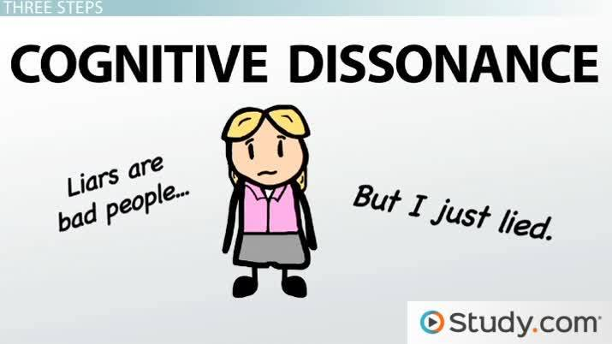

Slide 32
Using Cognitive Dissonance to Create Microtension:
What is cognitive dissonance?
Cognitive dissonance is a mental conflict that occurs when your beliefs don't line up with your actions. It's an uncomfortable state of mind when someone has contradictory values, attitudes, or perspectives about the same thing.
People with cognitive dissonance may experience‌:
Embarrassment over feeling wrong about the beliefs they previously held
Shame or regret about past actions or decisions
Guilt for hiding or something they believe is wrong
Discomfort for doing something that contradicts what they believe

Slide 33
How to Use Cognitive Dissonance:
Put readers into familiar narrative situations but deploy unexpected outcomes via character action or dialogue.
Bring secondary emotions to the forefront when characters react to conflict.
Explore unexpected areas of motivation for viewpoint characters. Create unexpected reasons behind their actions.
Explore incongruent visual details.
Explore incongruent metaphors to express an emotional state or set of circumstances.
You want to take a reader to unexpected emotional places, but they should still be relatable.
(In other words, you're going to lose the reader fi characters just act like maniacs all the time with no rhyme or reason behind their feelings of actions. )

Slide 34
Example of using cognitive dissonance: I'm Thinking of Ending Things by Iain Reid
It’s not just this Dairy Queen—it’s this place, this town, if it is a town. I’m unclear what makes a town a town, or when a town becomes a city. Maybe this isn’t either. It feels lost, detached. Hidden from the world. I’d go moldy out here if I couldn’t leave, if there was nowhere else to go.
Somewhere inside the silver machine, ice is being crushed and blended with concentrated lemon juice and lots of liquid sugar. No dairy, but it’ll be sweet, I’m sure of that.
The icy lemonade flows out of the machine into the second cup. When it’s full, the machine stops, and the girl puts a plastic cover on it, too. She carries them over to where I’m standing. Up close, she looks even worse. It’s her eyes.
“Thanks,” I say, reaching for the lemonade. I’m not expecting an answer, so I am taken aback when she speaks.
“I’m worried,” she mumbles, more to herself than me. I look around to see if the other girls hear her. They aren’t paying attention. Neither is Jake.
“Excuse me?”
She’s looking down at the floor. She’s holding her hands in front of her.
“I shouldn’t be saying this, I know I shouldn’t. I know what happens. I’m scared. I know. It’s not good. It’s bad.”
“Are you okay?”
“You don’t have to go.”
I can feel my pulse skipping ahead. Jake is getting straws, I think, and napkins from the dispenser. We won’t need spoons after all.
One of the girls laughs, louder this time. The skinny girl in front of me is still looking down, hair covering her face.
“What are you scared of?”
“It’s not what I’m scared of. It’s who I’m scared for.”
“Who are you scared for?”
She picks up the cups. “For you,” she says, handing me the cups before disappearing back into the kitchen.

Slide 35
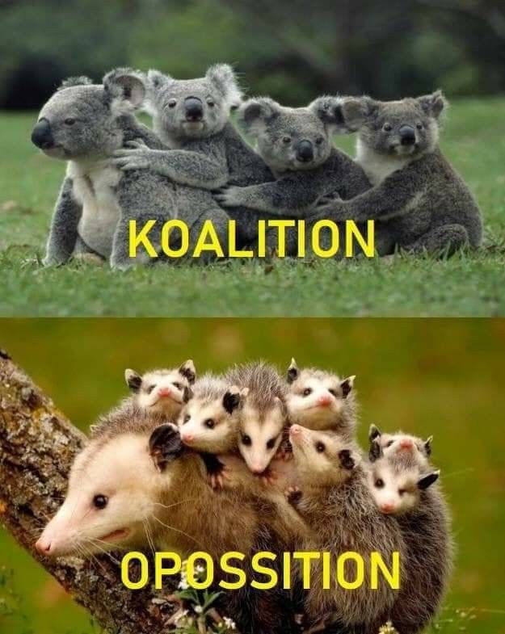
Opposition

Slide 36
Using Opposition to Create Microtension
Tension is often defined or understood to be basically some form of opposition, friction, conflict, an obstacle.
        But perhaps a better way to think of it in weaving it throughout your story is…
        Tension is anything contrary to a character’s (and reader’s) desires or expectations, however minor.

Slide 37
Example of using opposition to create microtension: We Were Liars by E. Lockhart
I didn’t realize he’d torn the house down. That the lawn was gone. And the trees, especially the huge old maple with the tire swing beneath it. That tree must have been a hundred years old.
A wave surges up, dark blue, leaping from the sea like a whale. It arches over me. The muscles of my neck spasm, my throat catches. I fold beneath the weight of it. The blood rushes to my head. I am drowning.
It all seems so sad, so unbearably sad for a second, to think of the lovely old maple with the swing. We never told the tree how much we loved it. We never gave it a name, never did anything for it. It could have lived so much longer.
I am so, so cold.
“Cadence?” Mummy is leaning over me.
I reach and clutch her hand.
“Be normal now,” she whispers. “Right now.”
“What?”
“Because you are. Because you can be.”
Okay. Okay. It was just a tree.
Just a tree with a tire swing that I loved a lot.
“Don’t cause a scene,” whispers Mummy. “Breathe and sit up.”
I do what she asks as soon as I am able, just as I have always done.

Slide 38
Layering Different Types of Tension
It’s possible to combine different types of Microtension
Setting, dialogue, action, exposition, backstory.
Who does it better than the incomparable Margaret Atwood?
This is an excerpt from the Handmaid’s Tale.
Note: Lack of quotation marks here means that this section is from the character’s memory

Slide 39
In here, said the Commander’s Wife. When I went into the sitting room she was already in her chair, her left foot on the footstool, with its petit point cushion, roses in a basket. Her knitting was on the floor beside the chair, the needles stuck through it.
I stood in front of her, hands folded. So, she said. She had a cigarette, and she put it between her lips and gripped it there while she lit it. Her lips were thin, held that way, with the small vertical lines around them you used to see in advertisements for lip cosmetics. The lighter was ivory-colored. The cigarettes must have come from the black market, I thought, and this gave me hope. Even now that there is no real money anymore, there’s still a black market. There’s always a black market, there’s always something that can be exchanged. She then was a woman who might bend the rules. But what did I have, to trade?
I looked at the cigarette with longing. For me, like liquor and coffee, they are forbidden.
So old what’s-his-face didn’t work out, she said.
No, ma’am, I said.
She gave what might have been a laugh, then coughed. Tough luck on him, she said. This is your second, isn’t it?
Third, ma’am, I said.
Not so good for you either, she said. There was another coughing laugh. You can sit down. I don’t make a practice of it, but just this time.
I did sit, on the edge of one of the stiff-backed chairs. I didn’t want to stare around the room, I didn’t want to appear inattentive to her; so the marble mantelpiece to my right and the mirror over it and the bunches of flowers were just shadows, then, at the edges of my eyes. Later I would have more than enough time to take them in.
Now her face was on a level with mine. I thought I recognized her; or at least there was something familiar about her. A little of her hair was showing, from under her veil. It was still blond. I thought then that maybe she bleached it, that hair dye was something else she could get through the black market, but I know now that it really is blond. Her eyebrows were plucked into thin arched lines, which gave her a permanent look of surprise, or outrage, or inquisitiveness, such as you might see on a startled child, but below them her eyelids were tired-looking. Not so her eyes, which were the flat hostile blue of a midsummer sky in bright sunlight, a blue that shuts you out. Her nose must once have been what was called cute but now was too small for her face. Her face was not fat but it was large. Two lines led downward from the corners of her mouth; between them was her chin, clenched like a fist.
I want to see as little of you as possible, she said. I expect you feel the same way about me.
I didn’t answer, as a yes would have been insulting, a no contradictory.
I know you aren’t stupid, she went on. She inhaled, blew out the smoke. I’ve read your file. As far as I’m concerned, this is like a business transaction. But if I get trouble, I’ll give trouble back. You understand?
Yes, ma’am, I said. Don’t call me ma’am, she said irritably. You’re not a Martha.

Slide 40
Sustaining Tension Throughout Your Story
At any given moment, we humans feel a number of different emotions, and they often clash. By going deep into your characters and drawing out that type of inner conflict as often as possible, you can bring microtension into your scenes.
Dialogue: What the character says vs. what she means.
Interior Dialogue: This is the conflict that’s going on within the character.
Emotion: There should be an underlying hint of an unfulfilled want or need.
Setting/Descriptors: Have the setting give insight about the character.

Slide 41
Tension Can be Subtle
Tension can be a no when the character wanted a yes, a frown when they hoped for a smile.
It’s the nervous rustle of a stomach amid a long-awaited kiss.
An arm snaking around a woman’s shoulders when she and her spouse run into her ex.
It’s the storm brewing outside when the character is running late for a crucial appointment.
The heaviness inside a house where an inhabitant has recently passed away.
The strained smile, the empty eyes, the acid laugh.

Slide 42
Three Ways to Add Microtension to your Scenes:
Dialogue: Examine each line of dialogue. Take out boring and unnecessary words and trivial matters.
Action: Think how to make an action incongruous. What does that mean? Real people are conflicted all the time. Have things happen and characters react in ways the reader does not expect.
Exposition: Find ways to add those conflicted emotions and create dissonance. Use word choices that feel contradictory. Find fresh, different ways to describe common things

Slide 43
Avoiding Low-Tension Traps:
Exposition. Be merciless in removing boring detail.
Backstory is the bane of virtually all manuscripts. As they say in the theater, make ‘em wait.
The scene-sequel-scene theory doesn’t work.
Use emotional conflict, competing desires, be safe
Travel is easy to skim. Unless the character’s interior life is vivid. or be happy. It’s the indecision that is compelling.

Slide 44
Avoiding Low-Tension Traps: (con’t)
Violence is easy to skip through.
Sex. Mechanical descriptions of tab-A-into-slot B descriptions of the physical act do not work.
Description is the thing readers are most apt to skip. Details need to show the interior conflict of the character.
Foreshadowing is most effective, not when it thunders at us, but when it stirs within the story’s characters a shift of emotion.
Details need to be surprising, conflicting, show struggle.
Static Moments: Places in the story when nothing is happening.

Slide 45


Slide 46
Exercise: Clustering to Reveal Microtension Possibilities
Clustering is the same as mindmapping
To create a cluster, you begin with a nucleus word, circled.
Flow with any current of connections that come to mind.
Write these down rapidly, each in its own circle, radiating outward from the center in any direction they want to go.
Connect each new word or phrase with a line to the preceding circle. When something new and different strikes you, begin again at the central nucleus and radiate outward until at some point you experience a sudden sense of what you are going to write about.

Slide 47
Exercise: Clustering to Reveal Microtension Possibilities
Look at your scene and identify the character’s emotions.
Cluster contradictory or positive and negative, emotions.
Now cluster those contrary emotions.
What do these feelings look, taste, sound, feel, smell like?
Who or what might relieve those feelings?
Who or what might make them worse?

Slide 48
Exercise: Clustering to Reveal Microtension Possibilities (con’t)
Look at your scene and identify the character’s emotions.
Cluster contradictory or positive and negative, emotions.
Now cluster those contrary emotions.
What do these feelings look, taste, sound, feel, smell like?
Who or what might relieve those feelings?
Who or what might make them worse?
Cluster until the random associations of your clustering suddenly take on coherence. This shift is movement from indeterminate form to focus.

Slide 49
Exercise: Clustering to Reveal Microtension Possibilities (con’t)
Find contradiction stemming from CONCEPT:
  Cluster your concept. If it’s a happy concept, what’s negative about it? If it’s a negative concept, what’s positive about it?
Find contradiction stemming from PLOT
  Cluster your logline. What opportunities, big and small and micro, does the story have to suggest the opposite of what actually happens?
Find contradiction stemming from THEME:
  Your thematic premise has an opposite statement and also suggests corollaries and contrary statements.
  Cluster your theme. Think of ideas that contradict your theme.
Find contradiction in CHARACTER’S INTERIORITY:
  Include character inner uncertainty or disbelief about what’s happening right now in the scene, in the moment. For example, show a character acting in a way that contradicts his desires.

Slide 50
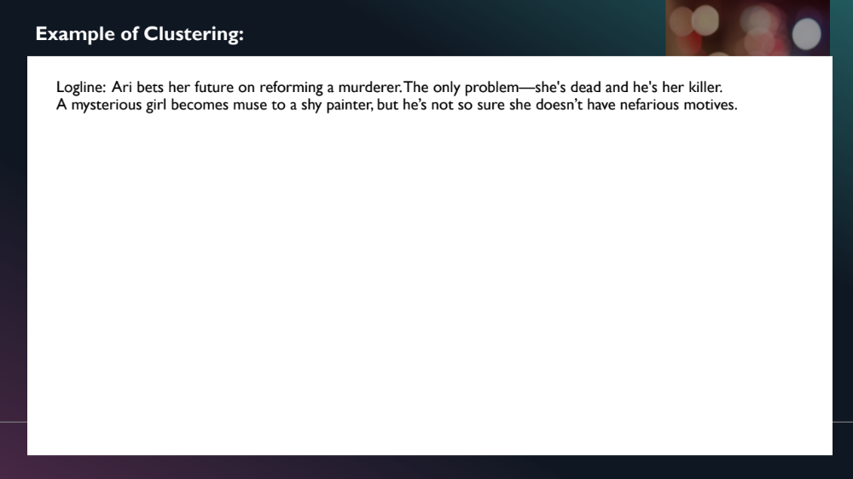
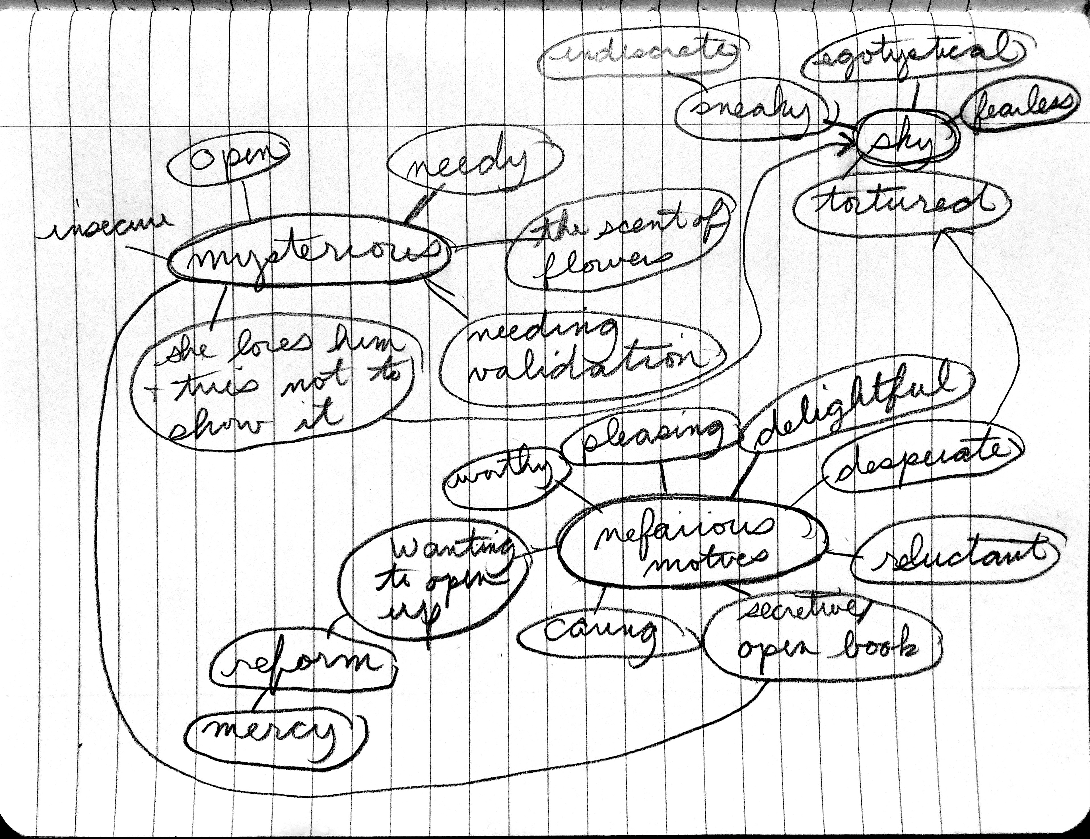
Example of Clustering:
Find the contradictions.
Logline:
A mysterious girl becomes muse to a shy painter, but he’s not so sure she doesn’t have nefarious motives.

Slide 51
What did you learn from the exercises?
What did you learn about your character’s conflicted emotion?
Did you find any way to add tension to your setting?
Did you find a way to add tension to your descriptions?
Did you find a way to add conflict to your dialogue?

Slide 52
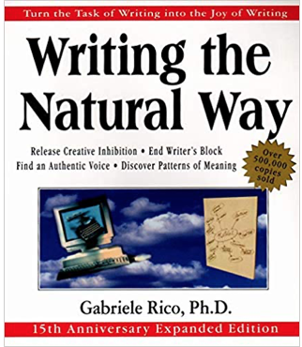


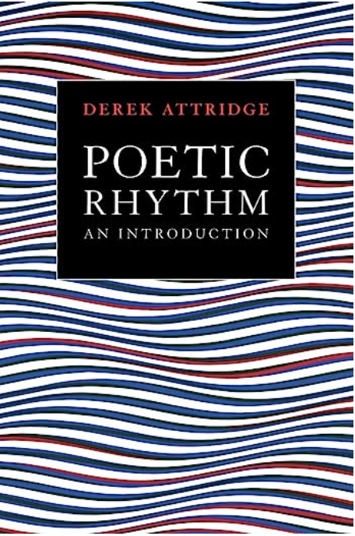
References:
The Fire in Fiction, by Donald Maas
Writing the Natural Way, by Gabriele Rico, Ph.D
Poetic Rhythm, by Derek Attridge

Slide 53

THANK YOU!
Sally Bosco
Website:
SallyBosco.com

